Slide 1
What is it?

Slide 2
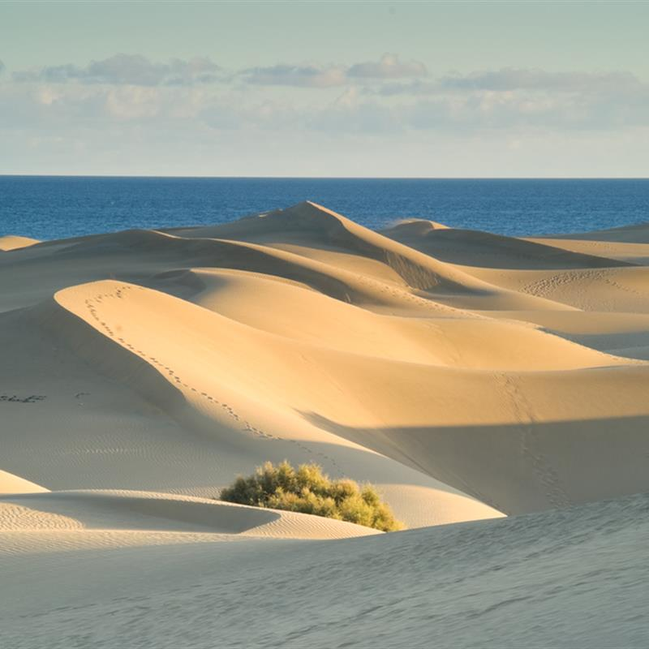
Dunes

Slide 3
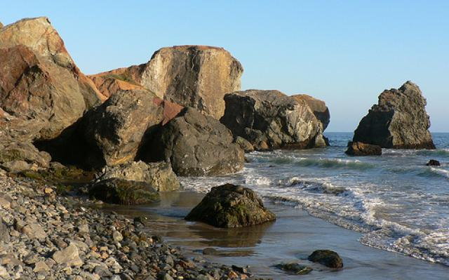
Rocks

Slide 4
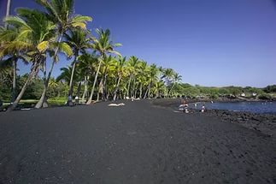
Black sand

Slide 5
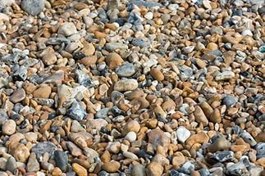
Pebbles

Slide 6
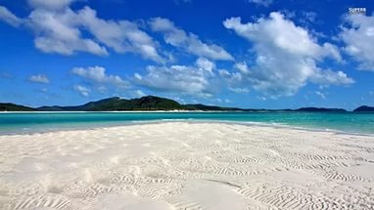
White sand

Slide 7
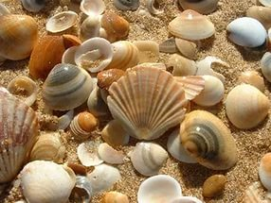
Shells

Slide 8
Answer the questions:
What beach were you on?
Did you like it?
What beach would you like to be on?
What beach is better / worse?

Slide 9
