Slide 1

BALLOG UISESS

Slide 2
Natural Disasters!

Slide 3
Natural disasters
Drought
Flood
Volcano eruption
Avalanche
Tornado
Landslide / Mudflow
Earthquake
Cyclone
Tsunami

Slide 4
Use passive!
People
Supplies
Tsunami
Bridges
Cars
Houses
bury
crack
rescue
generate
collapse
pull out
send
be

Slide 5
high / low pressure
consequences
a decade
melt (v)
rich soil
cause (v)
a shield
ash

Slide 6
Watch and answer the questions:
Floods
What can cause floods?
When do they usually happen?
When was a great Mississippi flood?
What were the consequences? (10? 56 000? 50?)
Is New Orleans above or below a sea level?

Slide 7
Droughts
What causes droughts?
What are the consequences?
For how many years did the drought last in 1930s?
For how many years can droughts last?
How can people go through it?

Slide 8
Volcano eruption
How many volcanoes are active on the Earth?
What is a Ring of Fire?
What causes volcano eruptions?
What is more dangerous than lava?
What is Kīlauea?
What was one of the most famous eruptions?
Can volcanoes be useful?

Slide 9
Earthquake
For how long did the earthquake in San Francisco (April, 1906) last?
How many people died?
How many people die every year because of Earthquakes?
What is a seismograph?
How can we protect themselves?

Slide 10
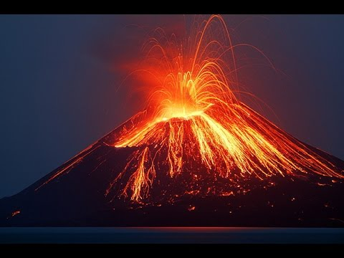
Volcano eruption

Slide 11
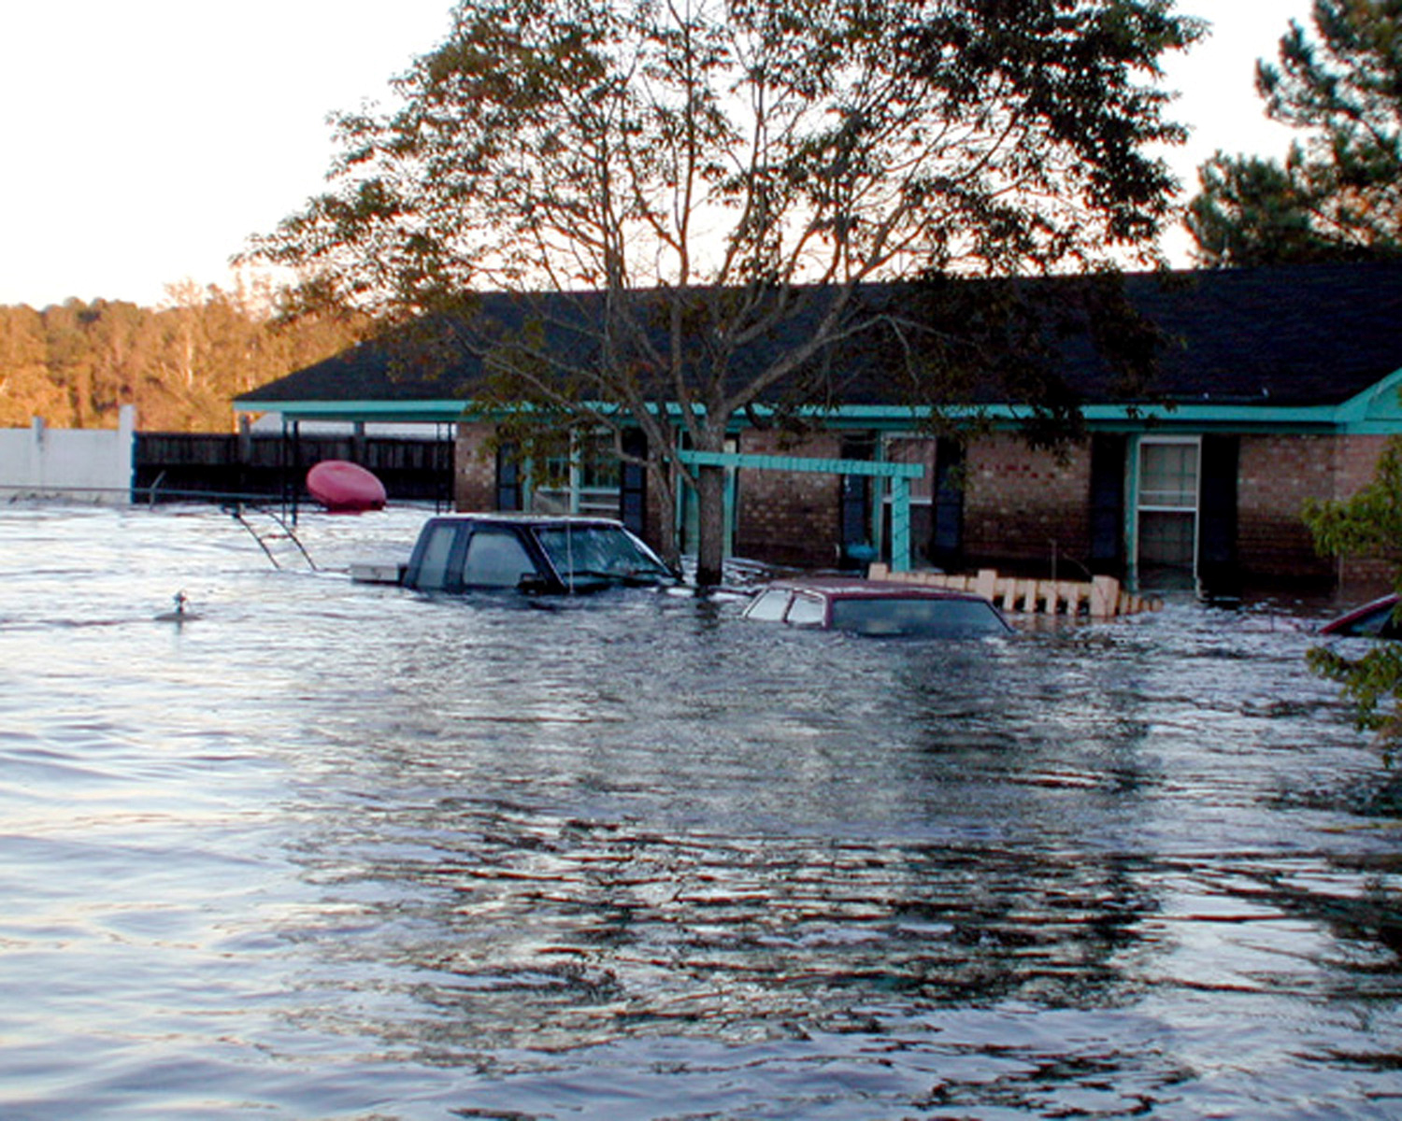
Flood

Slide 12
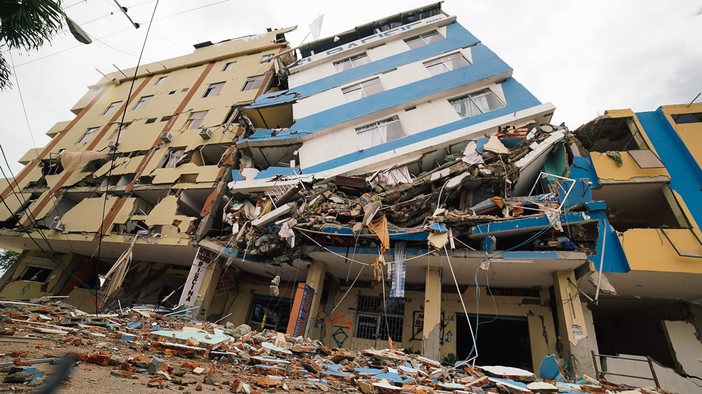
Earthquake

Slide 13
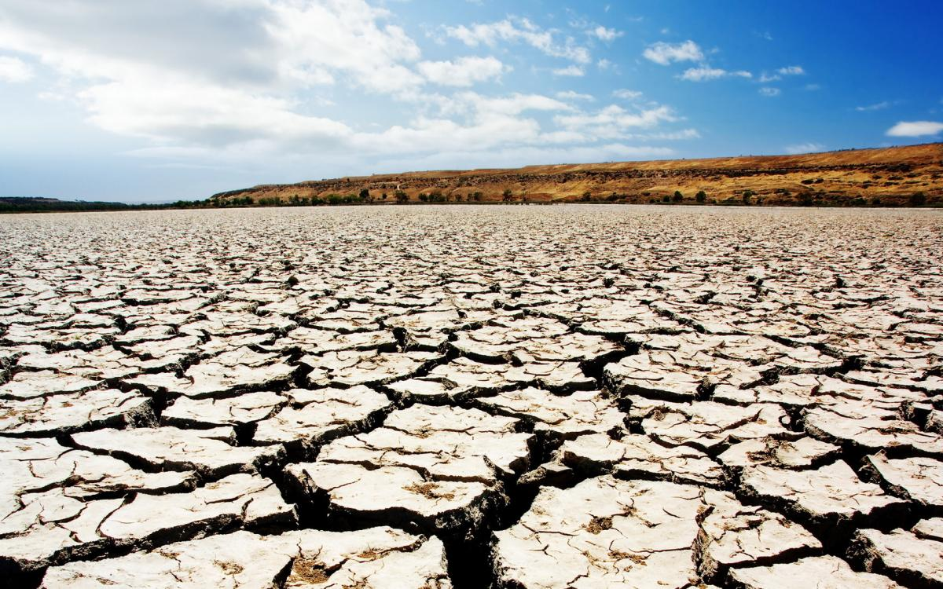
Drought

Slide 14
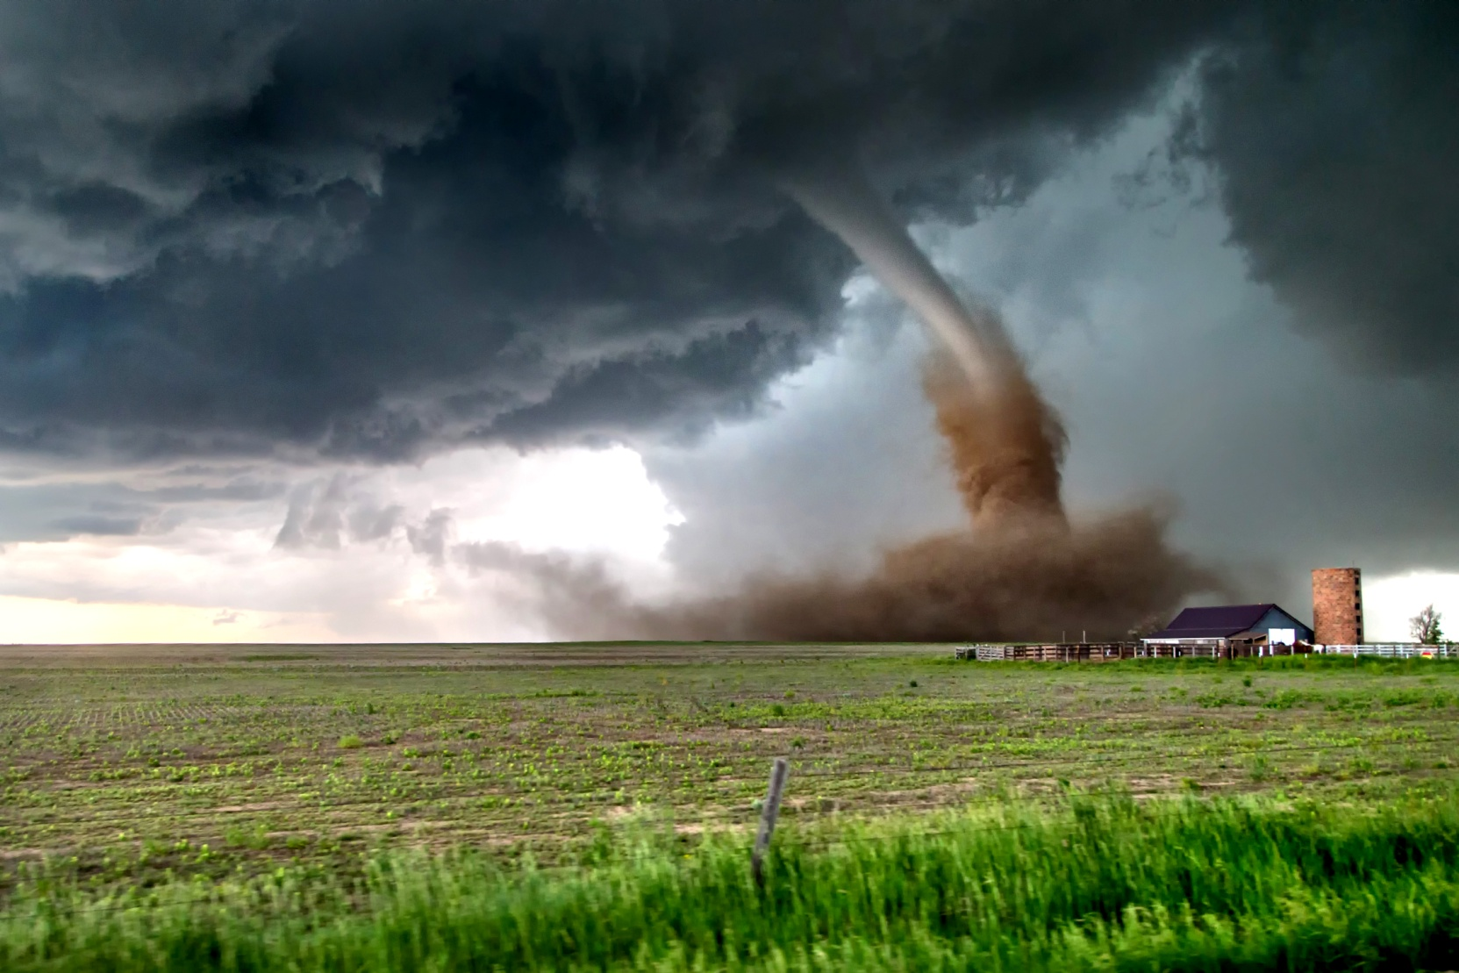
Tornado

Slide 15
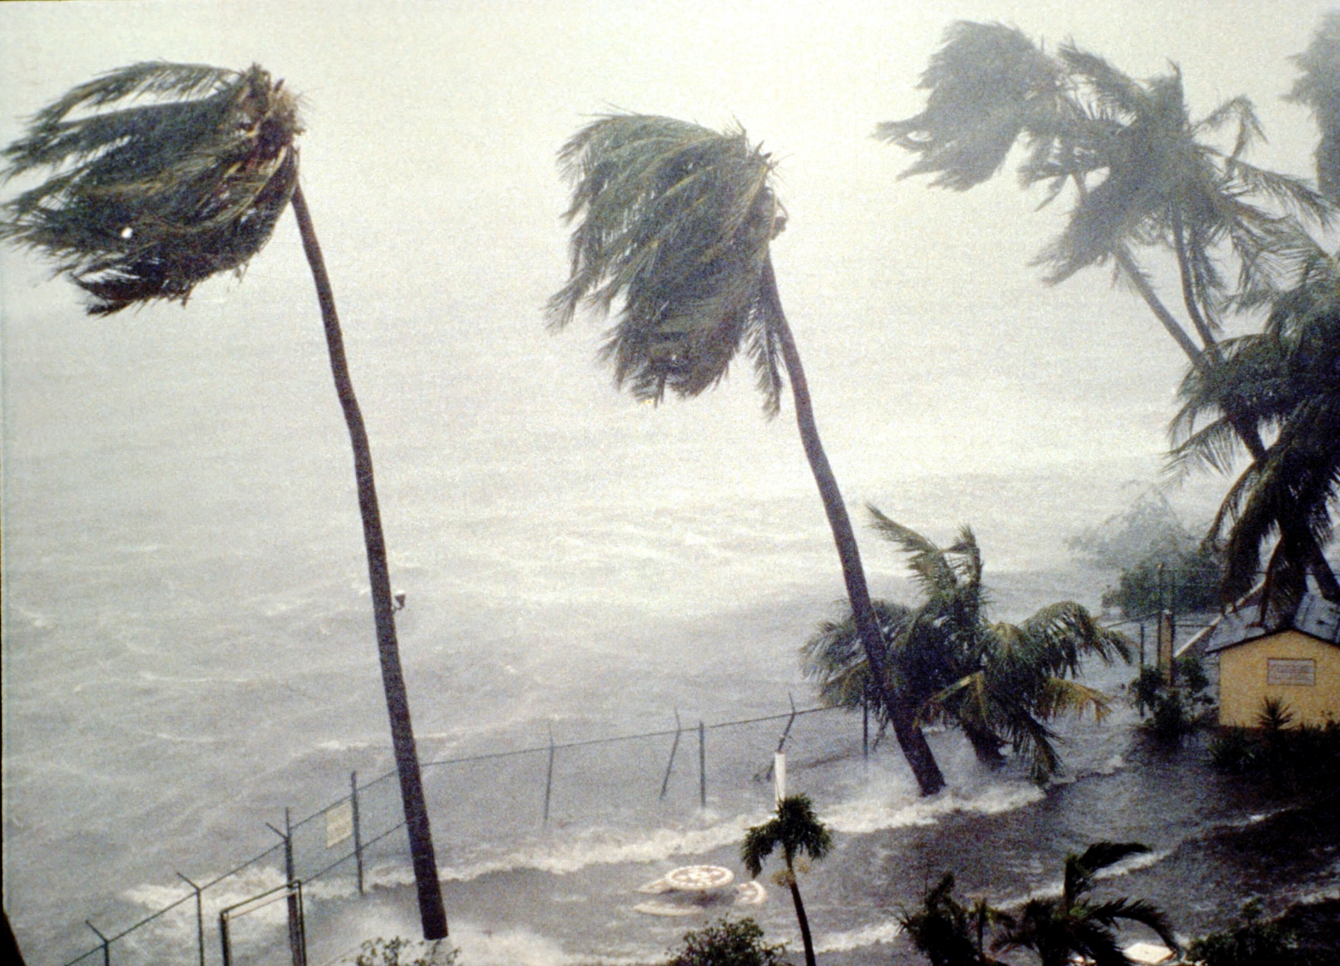
Hurricane

Slide 16
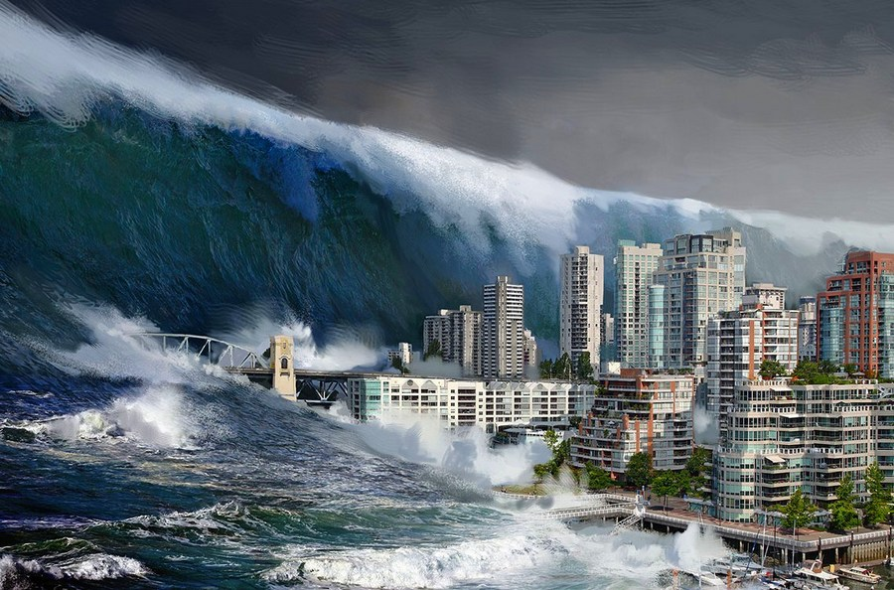
Tsunami

Slide 17
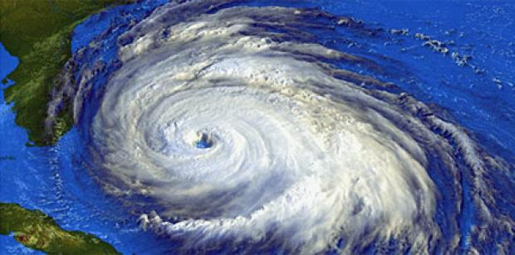
Cyclone

Slide 18
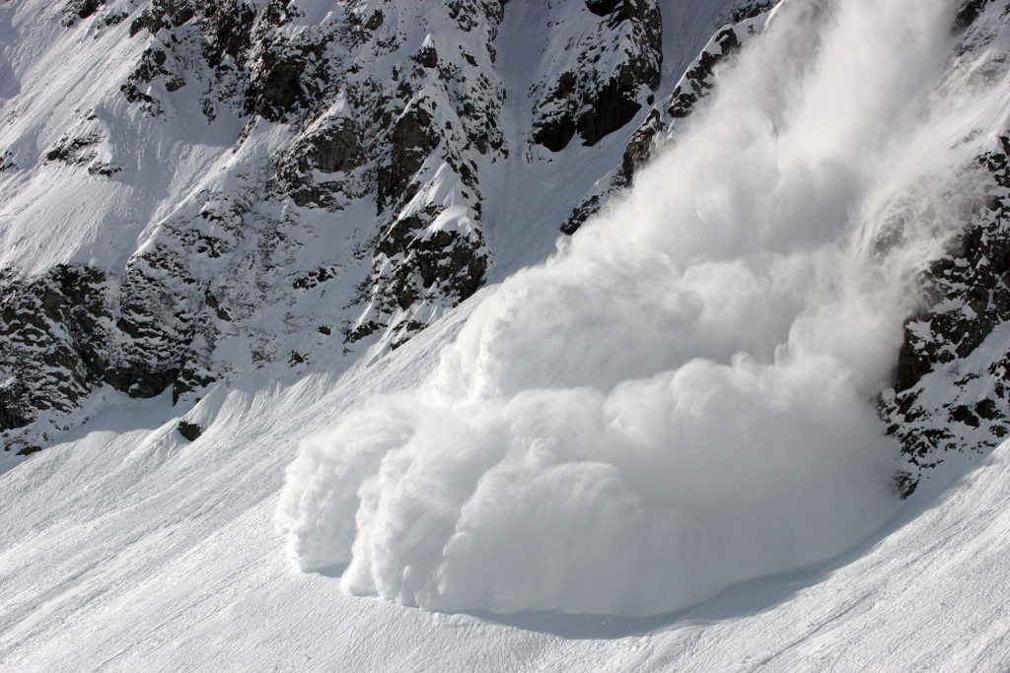
Avalanche

Slide 19
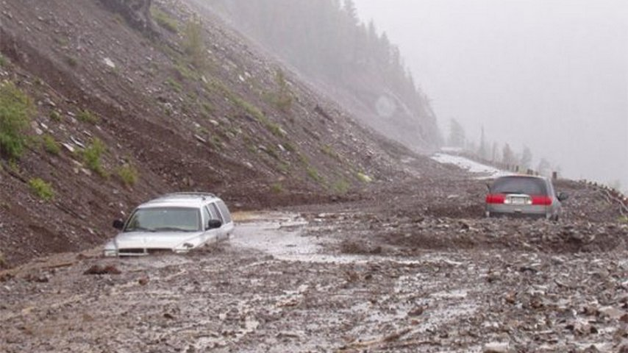
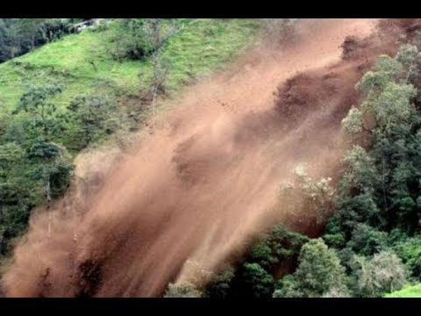
Mudflow / Landslide

Slide 20

What words correspond the pictures? Make up sentences:

Slide 21
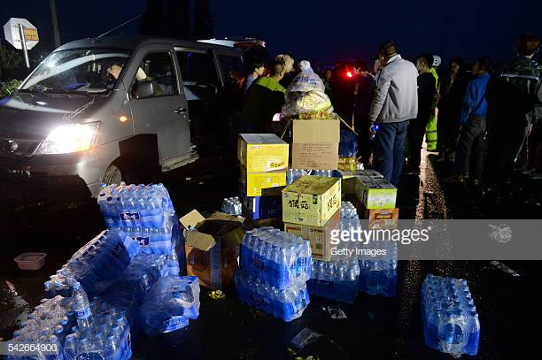
Supplies, distribute

Slide 22
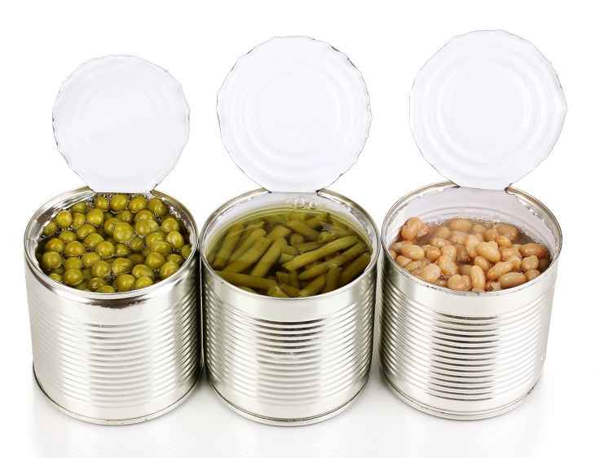
Tinned products

Slide 23
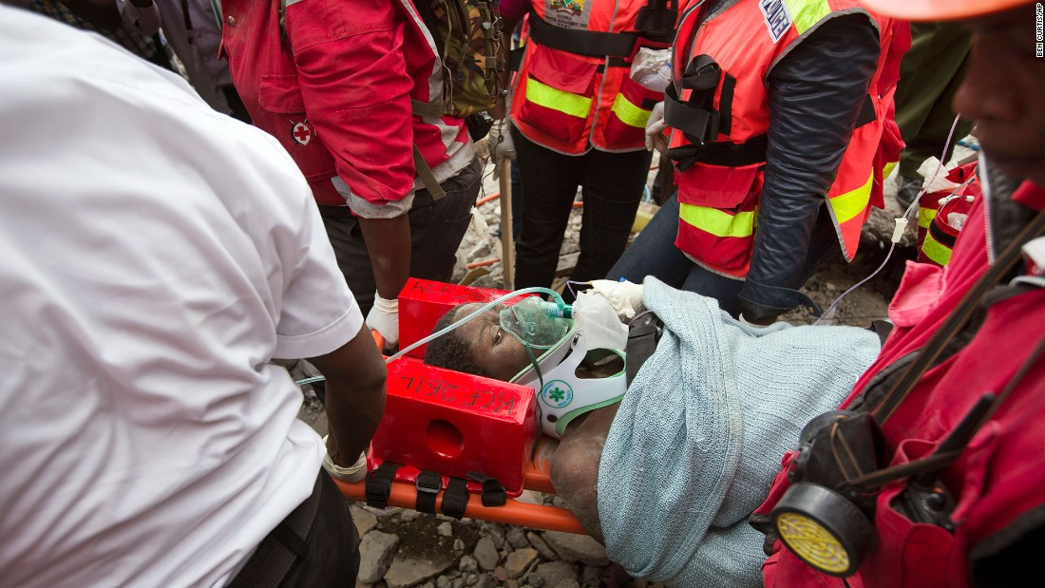
Survivors, injured people

Slide 24
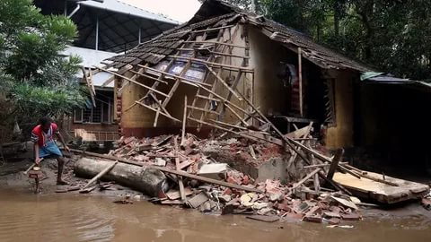
A cracked house/ building

Slide 25
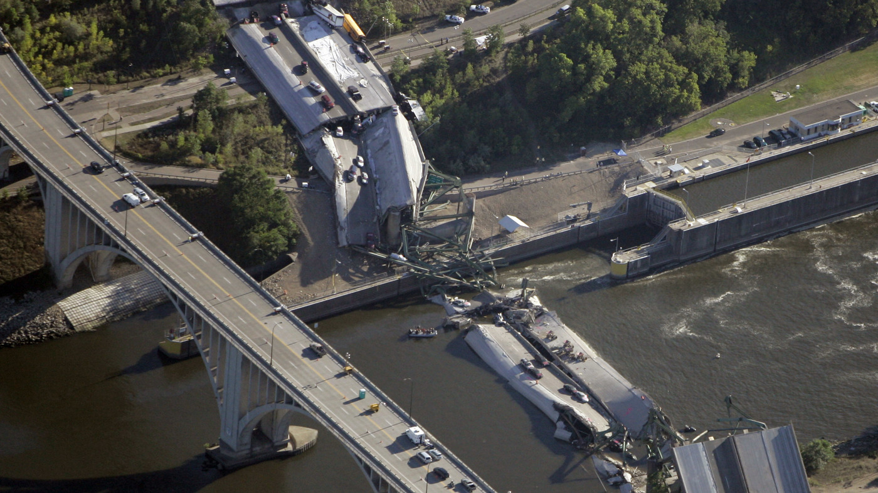
A collapsed bridge

Slide 26

Buried (bury)

Slide 27


Slide 28
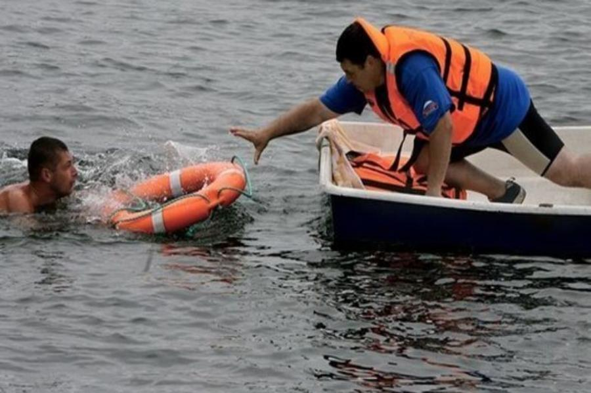
Drown, pull out of

Slide 29
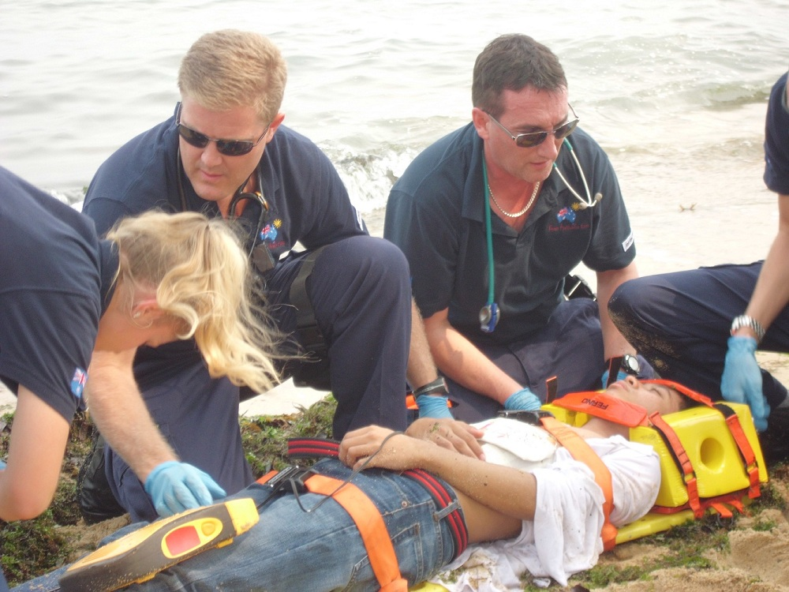
Rescue, first aid

Slide 30


Slide 31
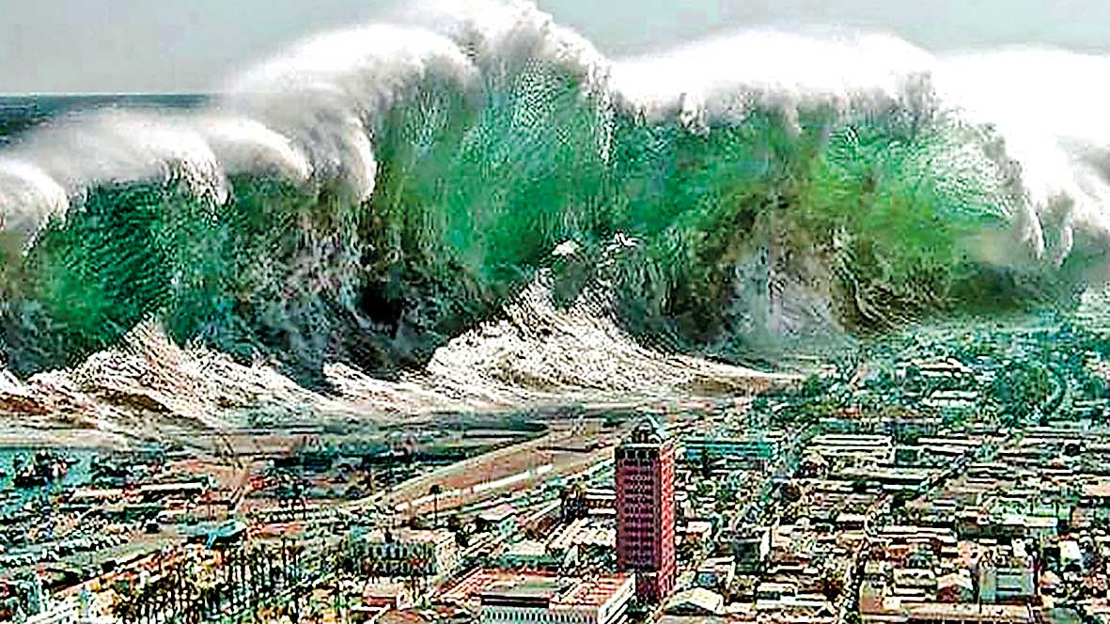
Generate, massive wave

