Slide 1










Slide 2
Board words:
Throw / roll the dice
Move the pieces
Pick up

Slide 3



Slide 4

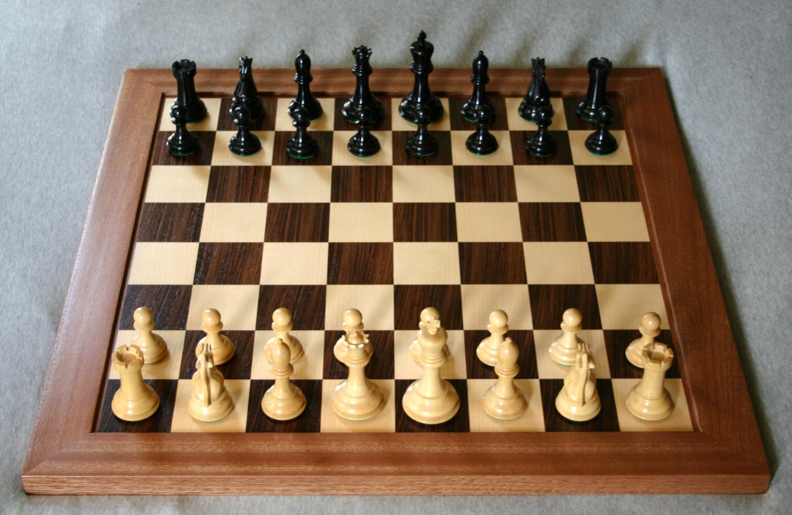

Slide 5

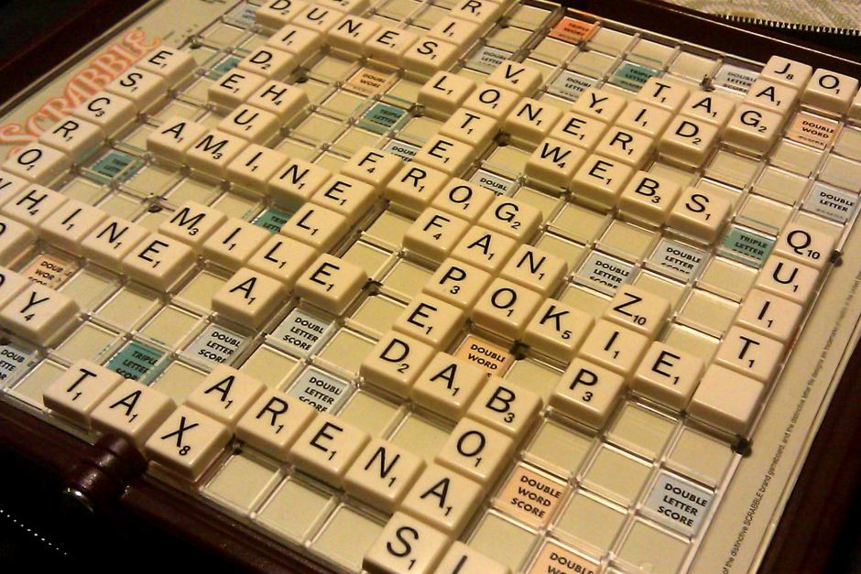

Slide 6

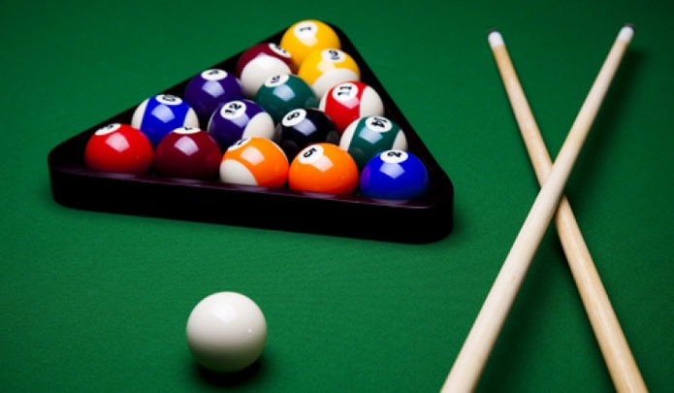

Slide 7
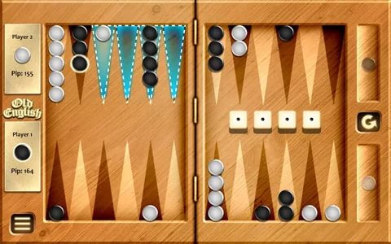

Slide 8
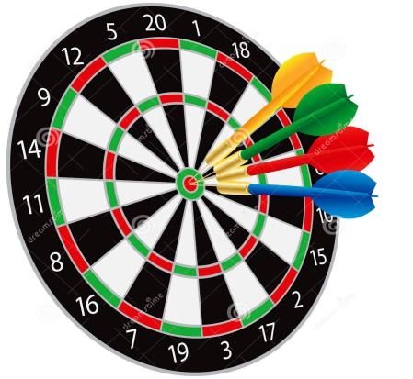

Slide 9
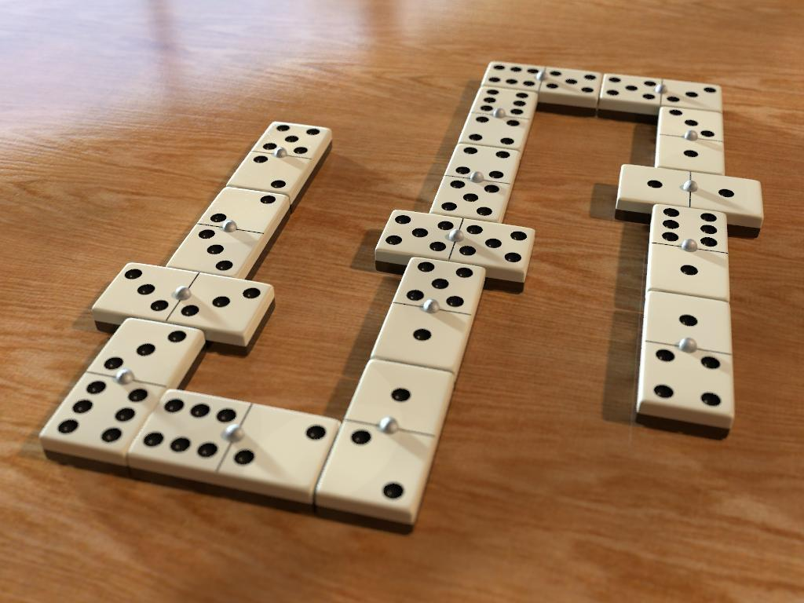

Slide 10
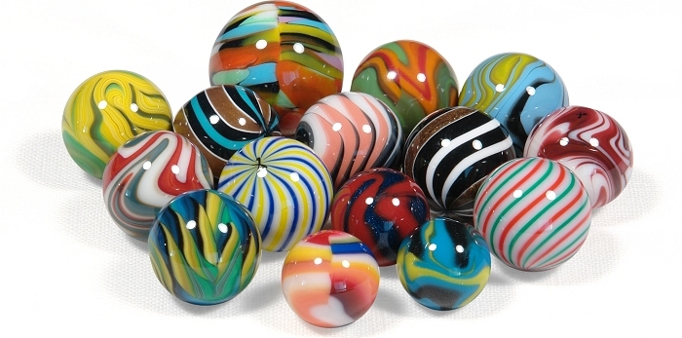

Slide 11
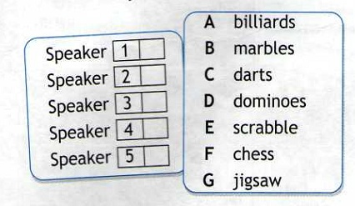

Slide 12
F
E
C
G
B

Slide 13
1. Make up and answer the questions
What are you | good | in?
 | fond | about?
 | interested | of?
 | mad | at?

Slide 14
My favourite board game.
I’m (not) fond of / keen on / interested in …board games
My favourite board game is …
This game is for …
The aim of the game is to …
The game is … (what is it like)
I enjoy this game because …

Slide 15
Present Simple / Present Continuous?
she | often | wear | jeans
you | wear | jeans now?
it | rain | now?
it | often | not to rain | in my country
you | study | English every day?
I | study | English at the moment

Slide 16
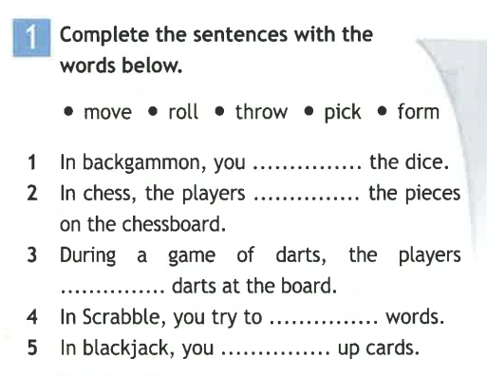

Slide 17
