Slide 1
Name a type of dwellings

Slide 2
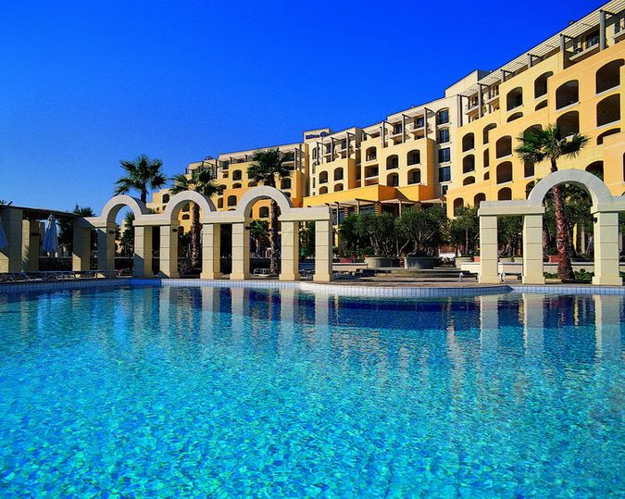
A hotel

Slide 3
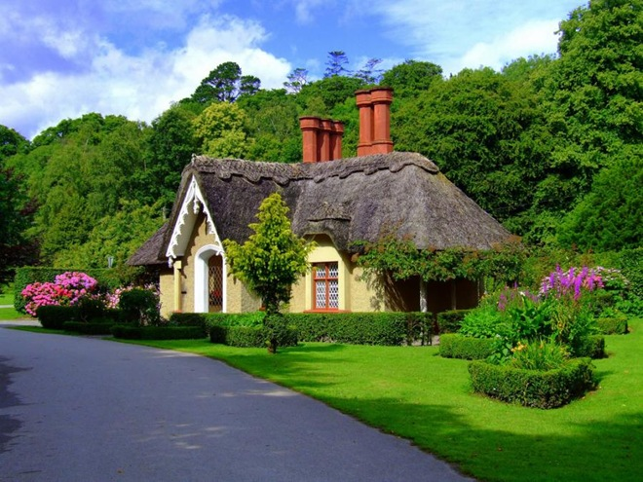
A cottage

Slide 4
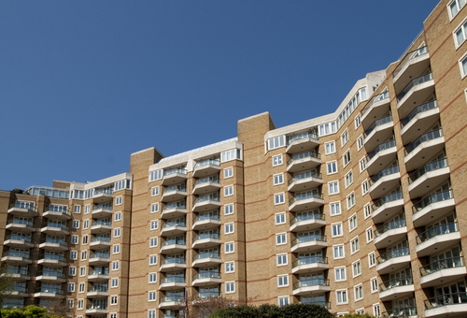
A block of flats

Slide 5
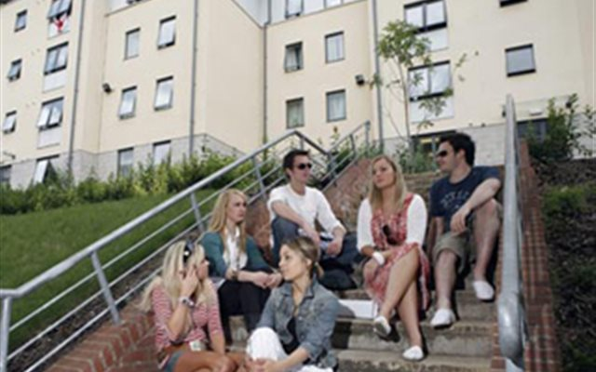
University halls of residence

Slide 6
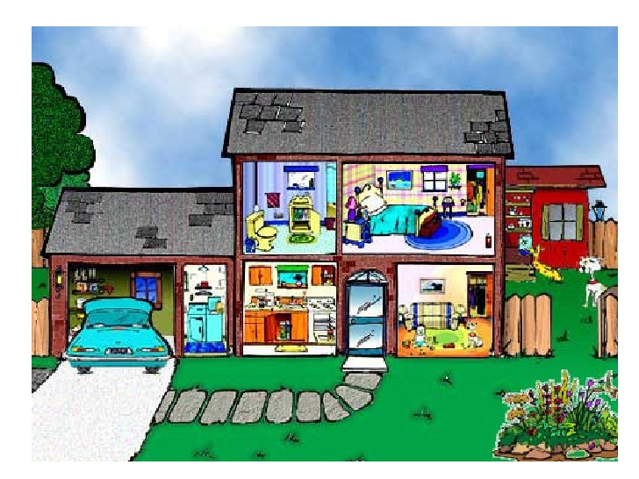
A house

Slide 7
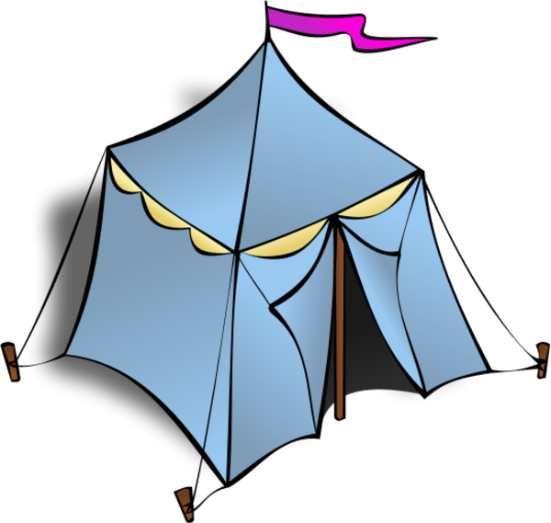
A tent

Slide 8
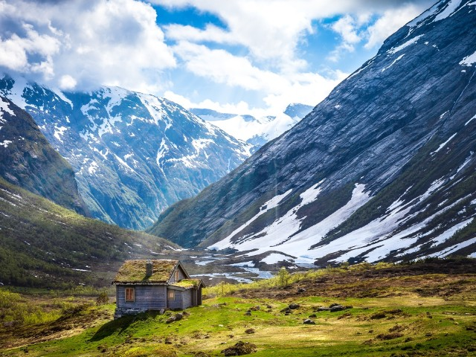
A mountain cabin

Slide 9
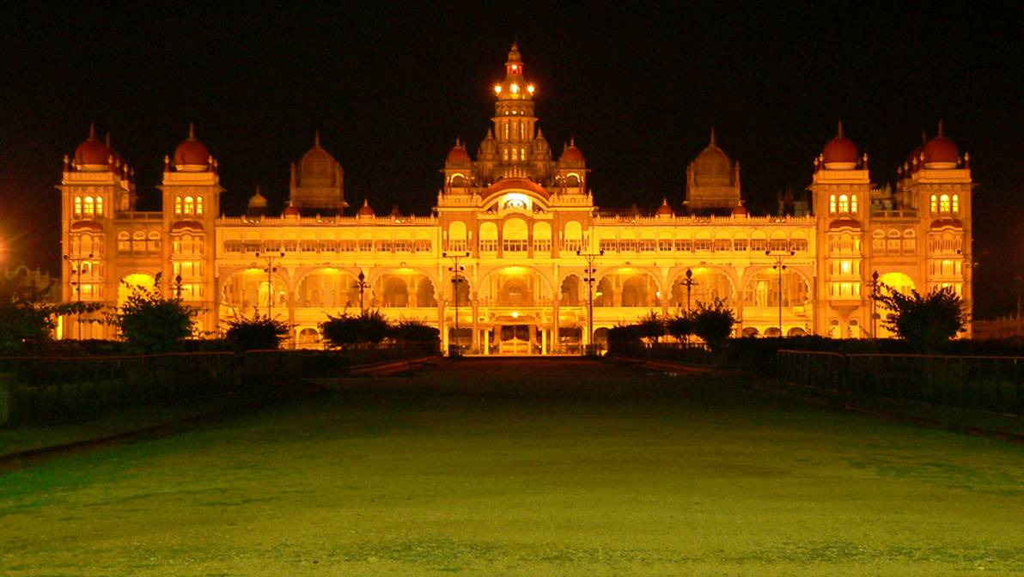
A palace

Slide 10
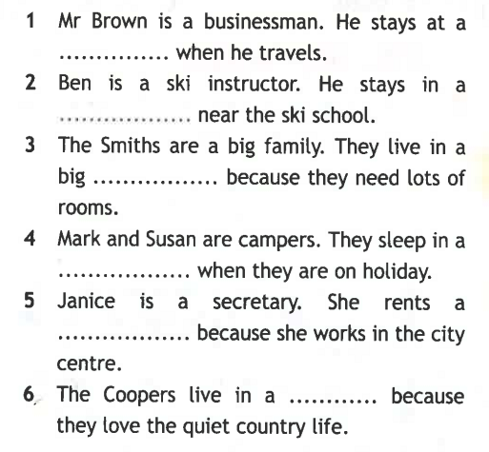

Slide 11
Barefoot, squirrels, overnight, study week, register, exam, remove
You mustn’t feed … here.
You mustn‘t … things from the museum.
Guests must … at a hotel.
You can walk … in my room.
You can stay … in my house.
You mustn’t play computer games long during … .
You mustn’t talk during … .

Slide 13
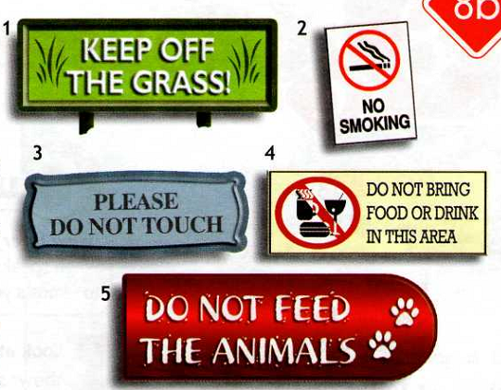

Slide 14

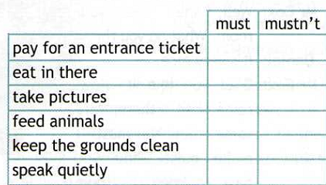


Slide 15
Marcel’s
Castella
Antonio’s
is
crowded
cheap and quiet
expensive

Slide 16
Name a place in town

Slide 17
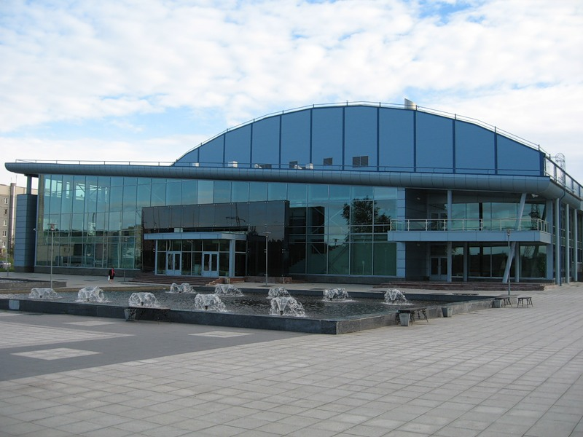
A sports centre

Slide 18
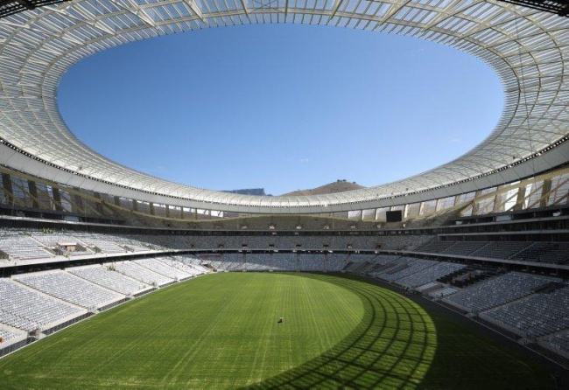
A stadium

Slide 19
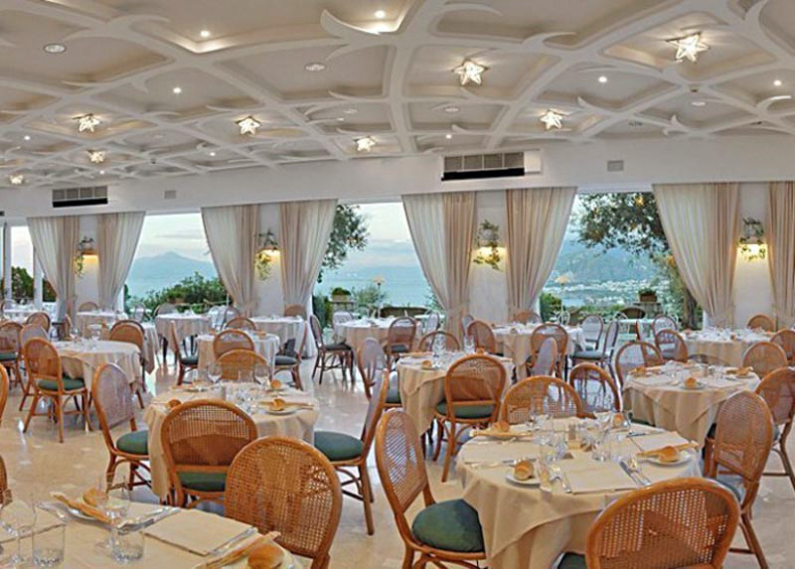
A restaurant

Slide 20
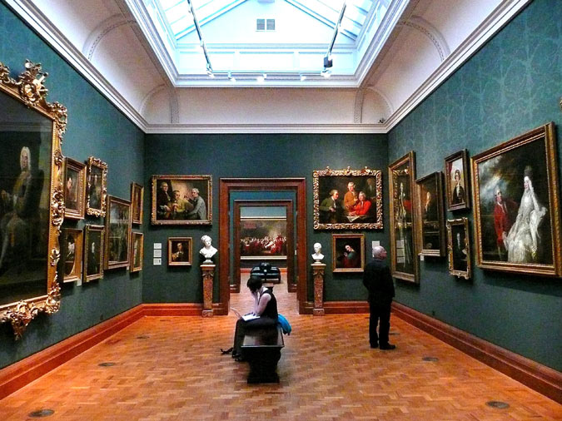
A gallery

Slide 21
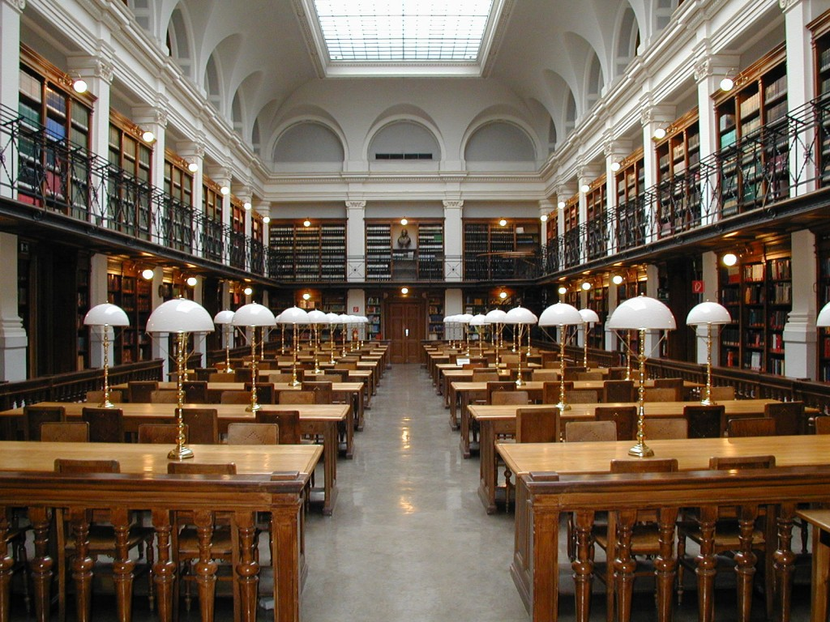
A library

Slide 22
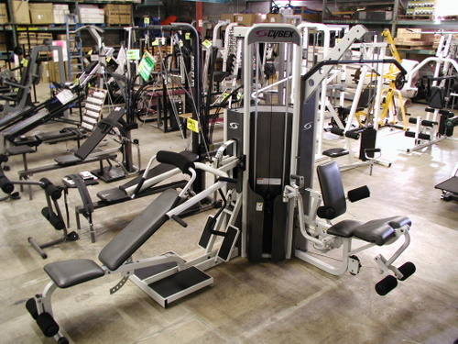
A gym

Slide 23
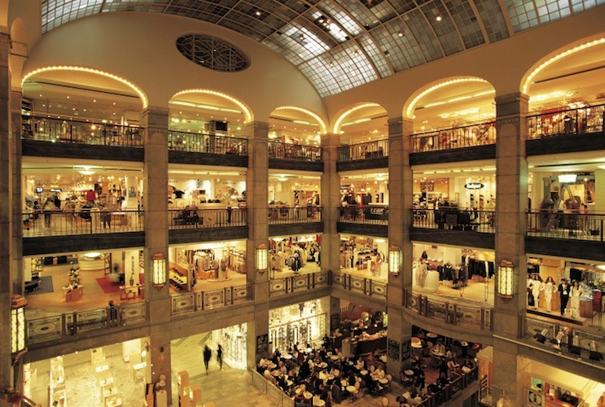
A department store

Slide 24
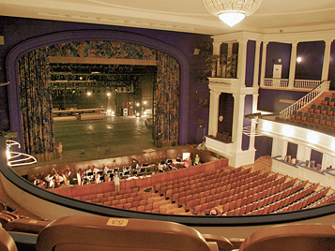
A theatre

Slide 25
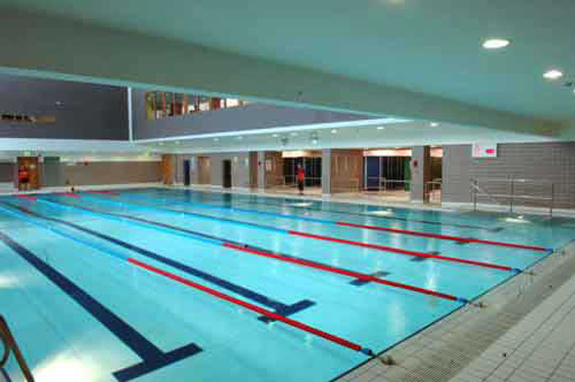
A swimming pool

Slide 26
Answer the teacher’s questions:
Where can you… ?
I can … in the …
2. Where were you …?
I was in the …

Slide 27
Сравни два слова через прилагательное:
A hotel / big / a tent
Model: A hotel is bigger than a tent
A plane / fast / a car
Summer / good / autumn
My sister / young / me
January / cold / September
A restaurant / expensive/ a café

Slide 28
Daniel rents a room. What he can and can’t do?
 | can | can’t
make noise
keep room tidy
friends … come round
bring food from a dining room
have snacks and soft drinks

Slide 29


Daniel rents a room. What he can and can’t do?
 | can | can’t
make noise
keep room tidy
friends … come round
bring food from a dining room
have snacks and soft drinks

Slide 30
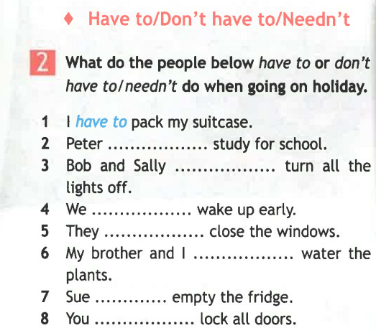

Slide 31
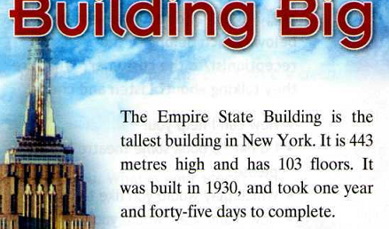

Slide 32
It has … floors / shops / offices / restaurants …
There is / are … in …

Slide 33


Slide 34
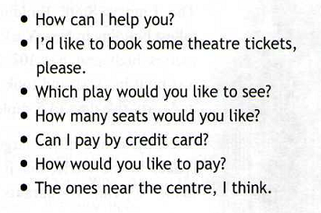

Slide 35
Answer the questions:
What’s the play?
When is it?
How many seats are needed?
How much do they cost?
How did he pay?
What’ his name?
When can he collect the tickets?

Slide 36
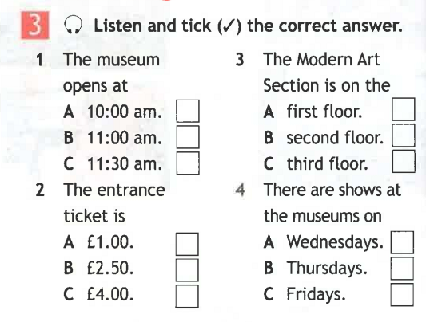

Slide 38
