Slide 1
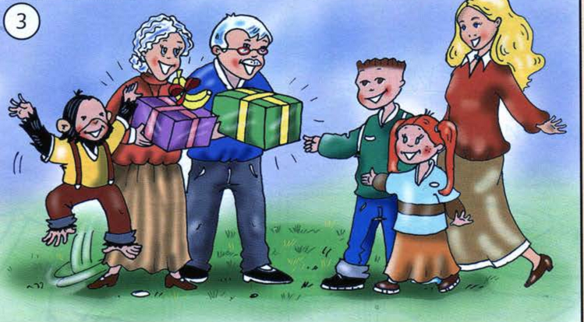
My family!

Slide 2
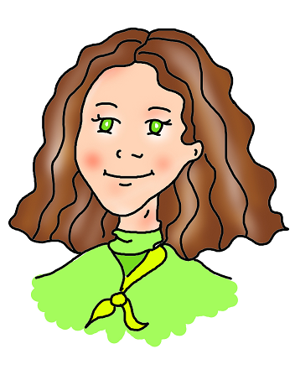
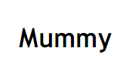
Who’s this?

Slide 3
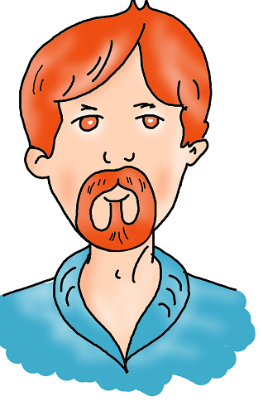

Who’s this?

Slide 4
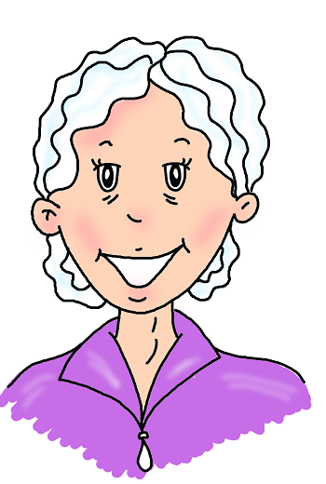
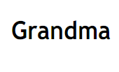
Who’s this?

Slide 5
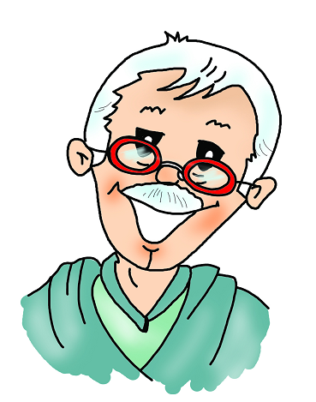
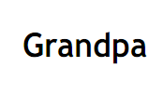
Who’s this?

Slide 6
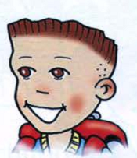

Who’s this?

Slide 7
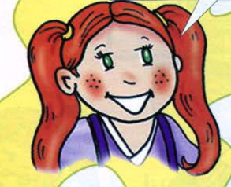

Who’s this?

Slide 8
Sister
Grandma
Brother
Daddy
Gradpa
Mummy

Slide 9
RED
DRE
LYEOWL
LBEU
NRGEE
THIEW
YELLOW
BLUE
GREEN
WHITE

Slide 10
Read the words!
Green
Yellow
Red
White
Blue

