Slide 1


Slide 2
p. 16 ex. 1,2
Match the pictures and phrases
What are people doing?
How do they feel?
What do people usually do on this day?
How do you usually feel on this holiday?

Slide 3
Name the picture and make up sentences:
People usually … on … .

Slide 4
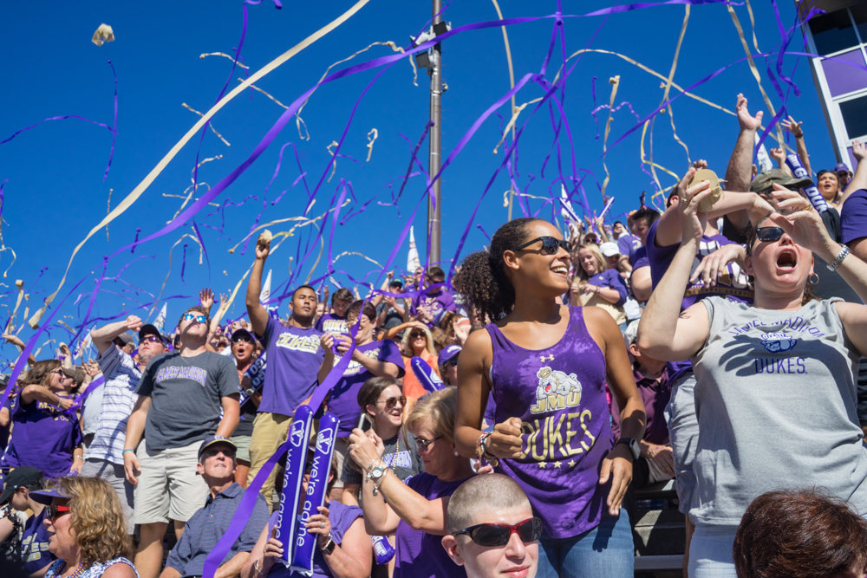
Throw streamers

Slide 5
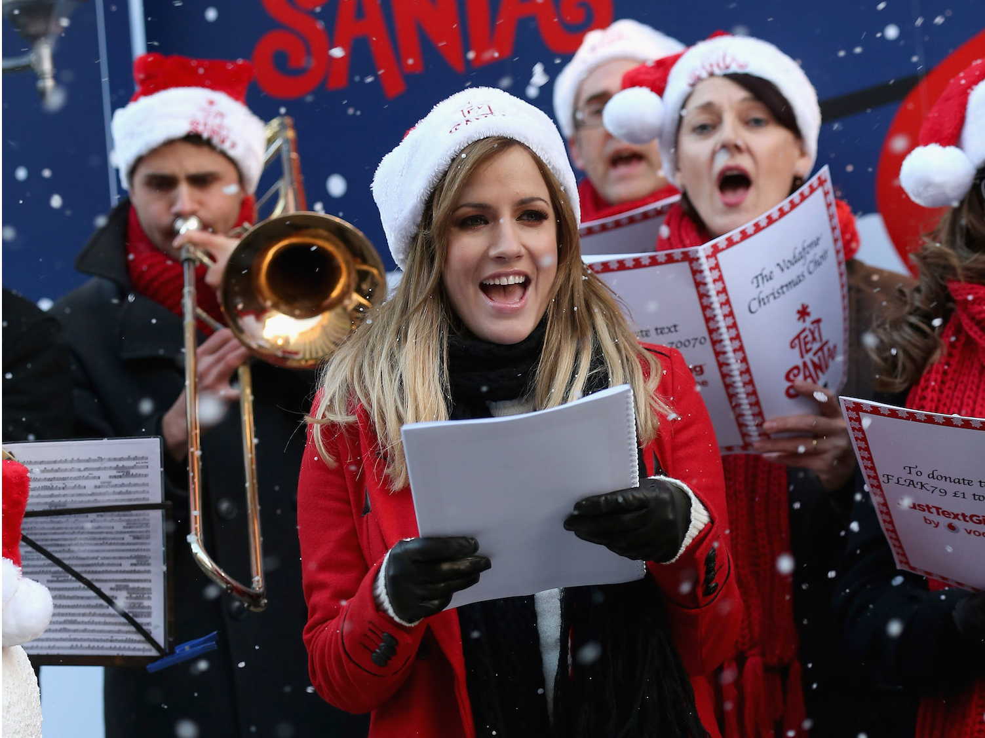
Sing carols

Slide 6
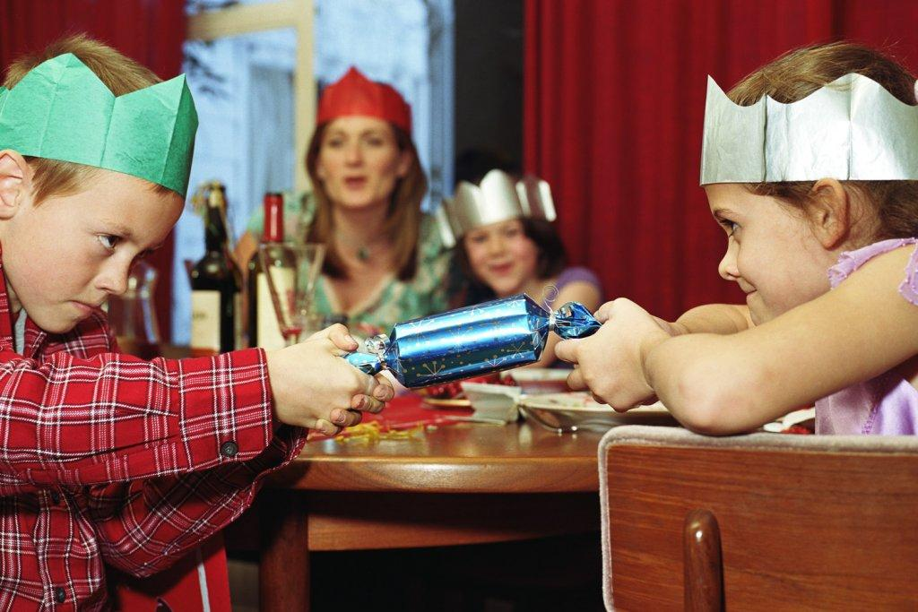
Pull crackers

Slide 7
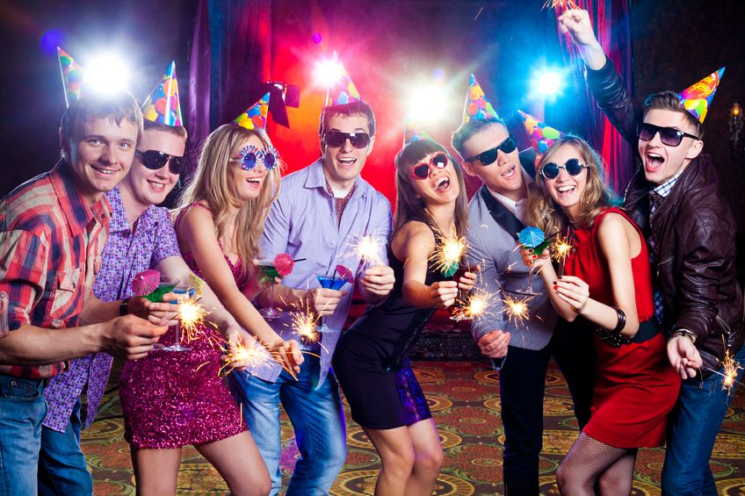
Have a party

Slide 8
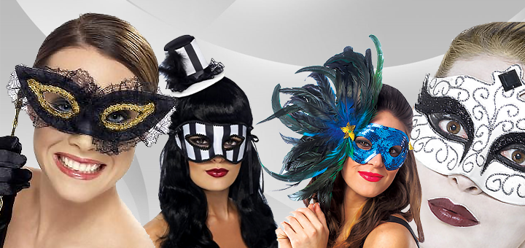
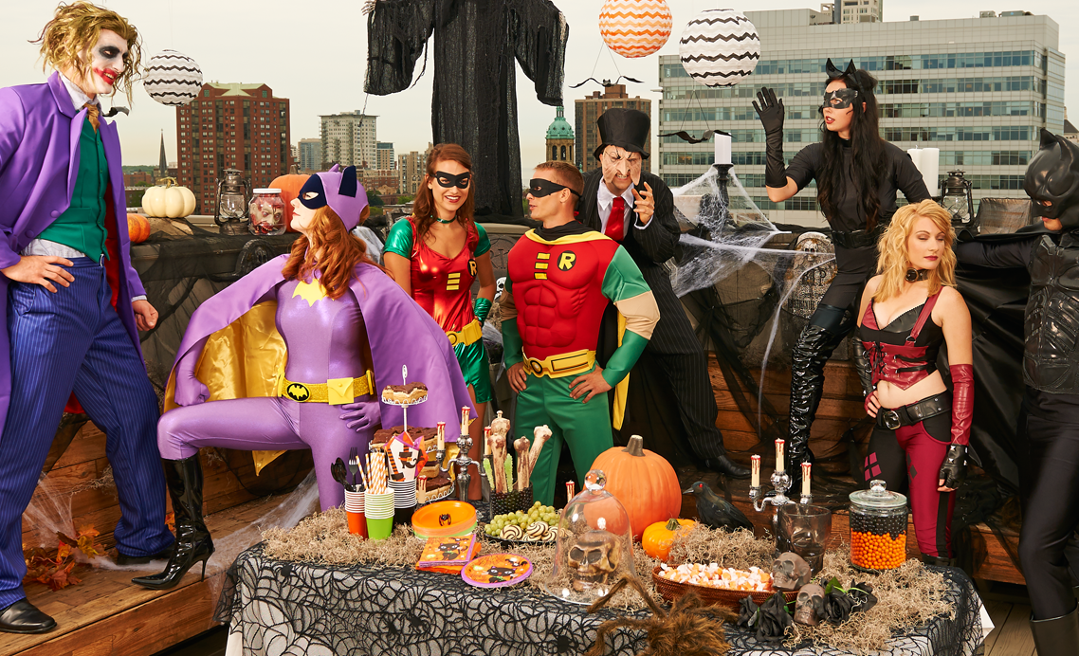
Dress up / wear masks

Slide 9
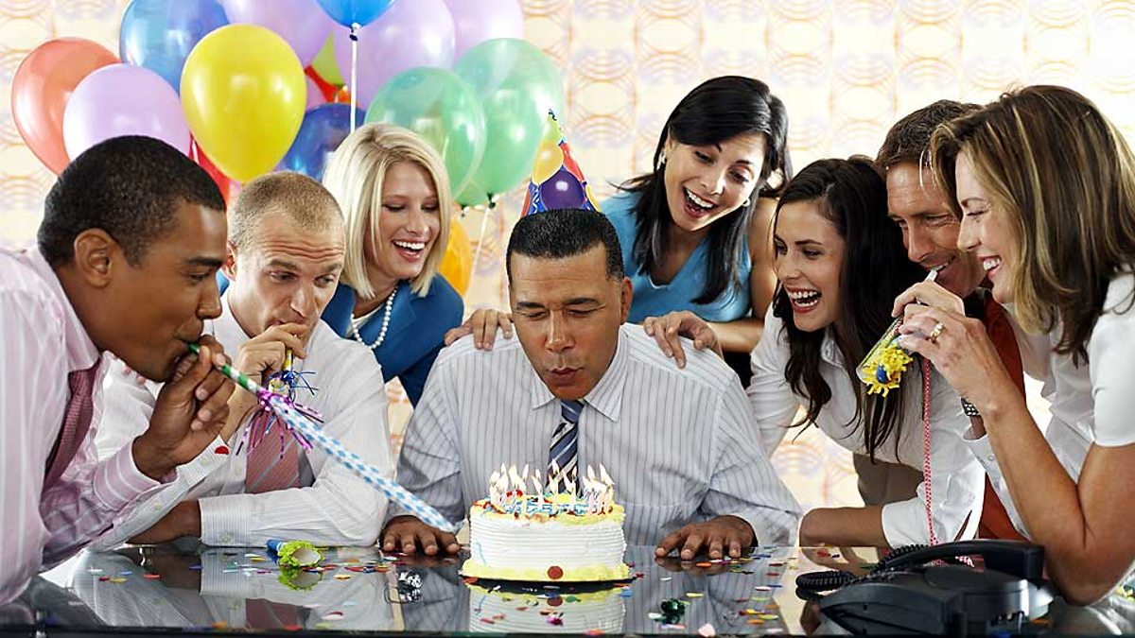
Blow out candles

Slide 10
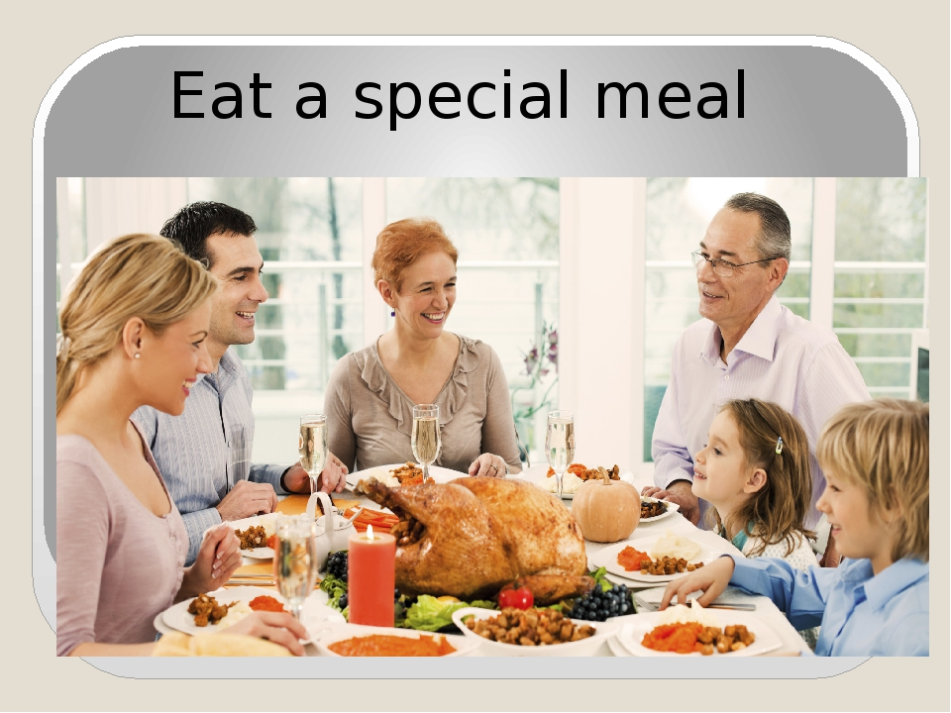

Slide 11
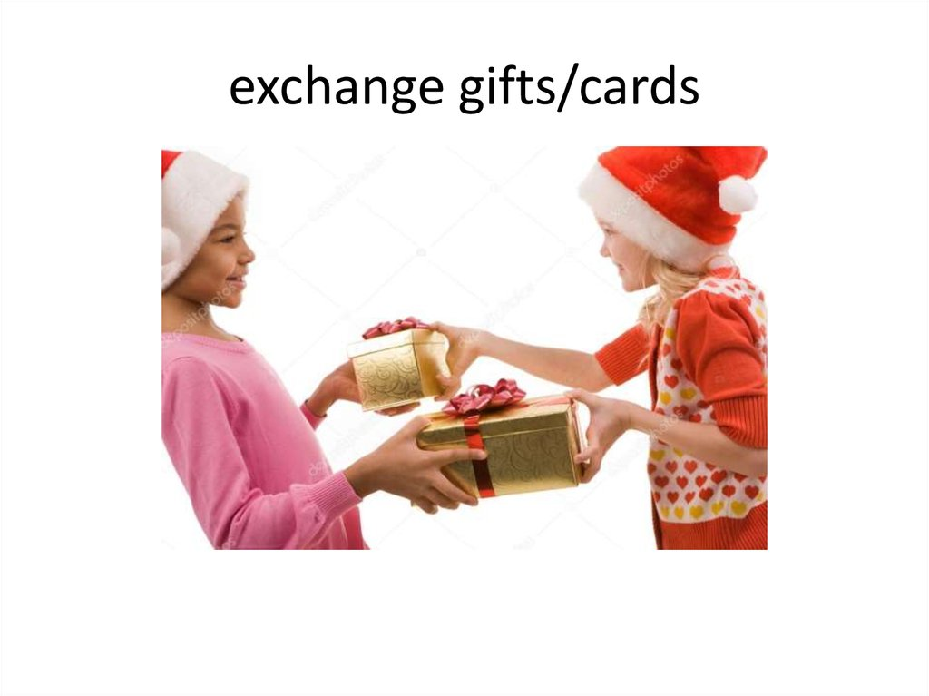

Slide 12
How do people feel when …?
Take an exam
Have a party
Enter a contest
Get an award
Let off fireworks
Make a wish
See a black cat

Slide 13
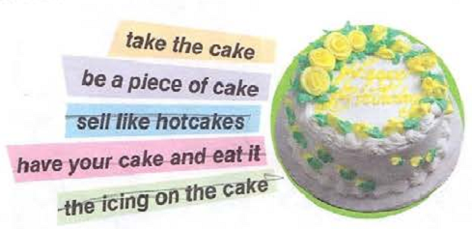

Slide 14
