Slide 1
What does it mean?
A mother
A father
A brother
A sister
A grandmother
A grandfather
A family
A son
A daughter

Slide 2
What does it mean?
A mother
A father
A brother
A sister
A grandmother
A grandfather
A family
A son
A daughter

Slide 3
Match
A mother
A father
A grandmother
A grandfather
a mother and a father
A grandmother and a grandfather
Mum
Grandma
Dad
Grandpa
Parents
Grandparents

Slide 4
Match
Make
Watch
Take
Play
Play
computer games
a toy
the stars
puzzles
a photo

Slide 5
Who? | Name? | Age? | What is he/she? | Can? | What is he/she like?

Slide 6
Who? | Name? | Age? | What is he/she? | Can? | What is he/she like?
Mother | Jane | 35 | a music teacher | play the guitar | clever
Father | David | 42 | a pilot | speak French | cool
Bother | Tom | 8 | a student | play computer games | naughty but caring
Grandma | Helen | 70 | retired | make cookies | kind and friendly
Grandpa | Ben | 72 | retired |  | funny
Sister | Emma |  | a baby |  | noisy

Slide 7
What does it mean?

Slide 8

Cool

Slide 9
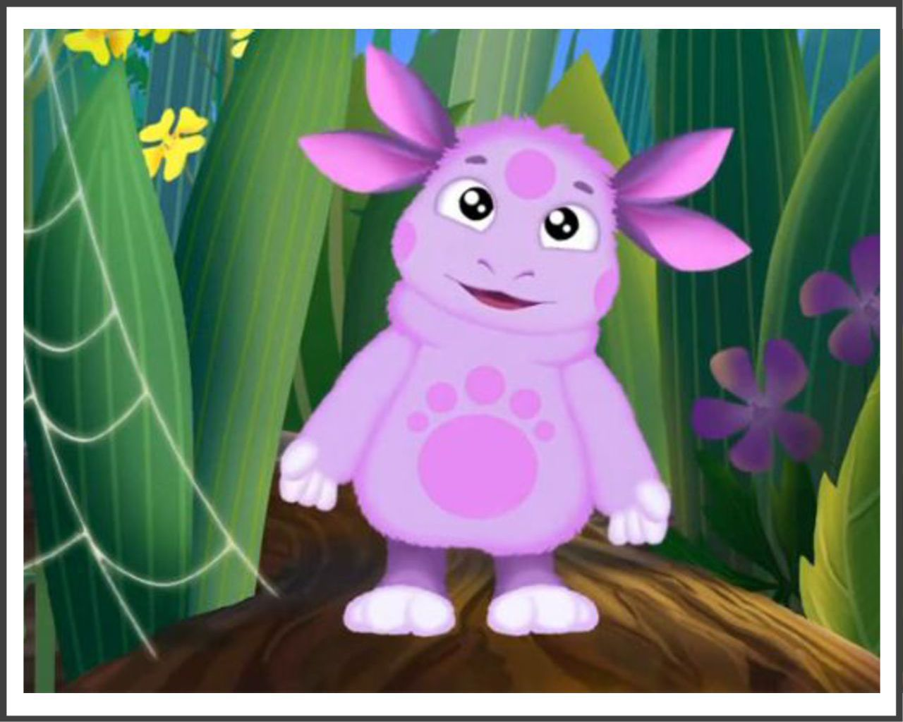
Kind

Slide 10
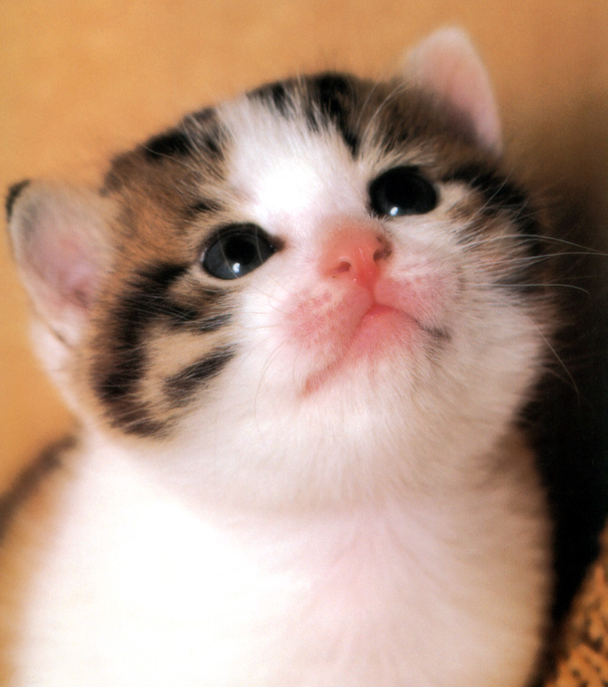
Sweet

Slide 11

Clever

Slide 12

Friendly

Slide 13
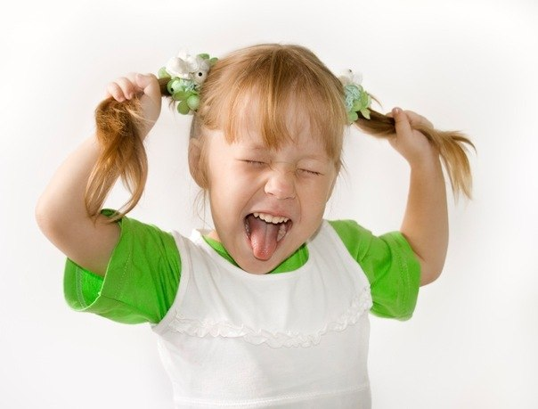
Noisy

Slide 14
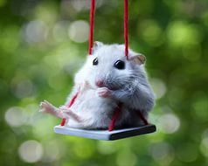
Funny

Slide 15
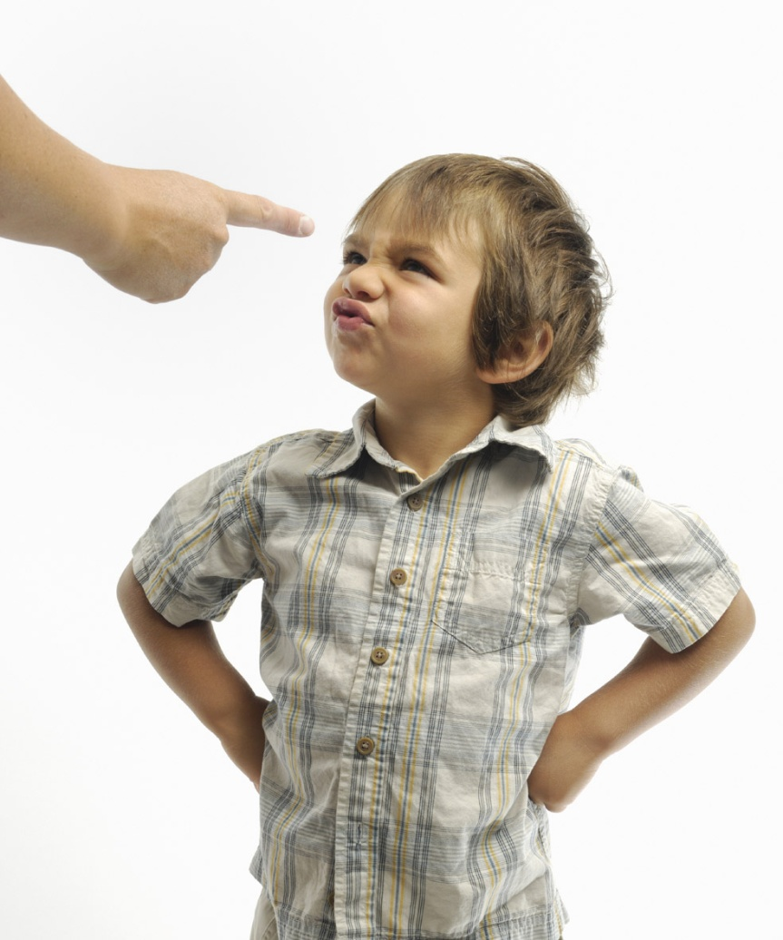
Naughty

Slide 16
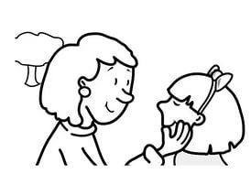
Caring

Slide 17
Find the mistakes!
He clever
He is clever.
She’s name Mary.
Her name is Mary
He office worker
He is an office worker.

Slide 18
Find the mistakes!
She can speaking.
She can speak.
He can make soup and very friendly.
He can make soup and he is very friendly.
He is 35 old and a director.
He is 35 (years old) and he is a director.

Slide 19
Kind

Slide 20
Sweet

Slide 21
Cool

Slide 22
Clever

Slide 23
Friendly

Slide 24
Noisy

Slide 25
Funny

Slide 26
Naughty

Slide 27
Caring

Slide 28
Answer the questions:
What is your mother like?
What is your father like?
What is your brother like?
What are your friends like?
What are you like?

Slide 29
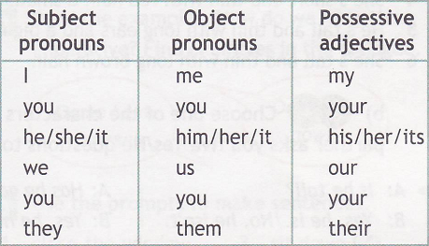

Slide 30
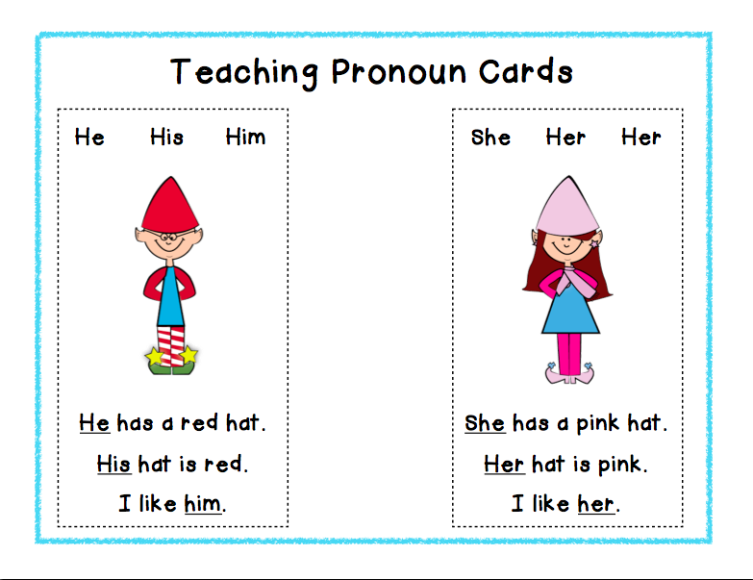

Slide 31
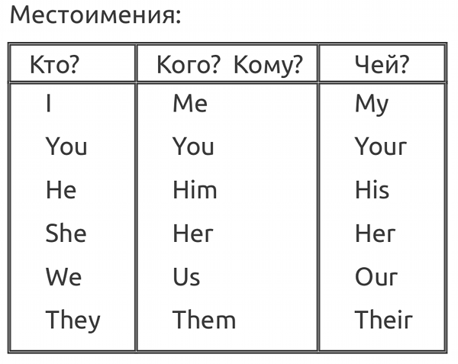

Slide 32
its, we, his, him, her
That’s Mike and that’s _______ sister.
Peter ‘s got a sister. ______ name is Lucy.
______ are twins. Our eyes are the same.
Look at the cat! ____ ears are so funny!
This is Ben’s book. Give it to _______!

Slide 33
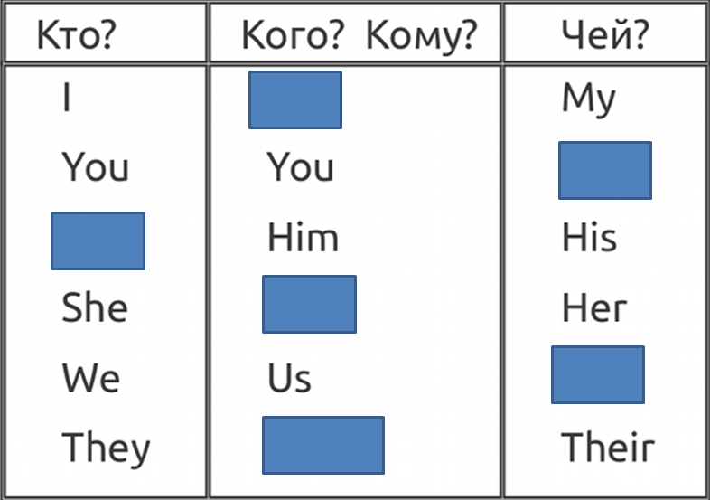

Slide 34
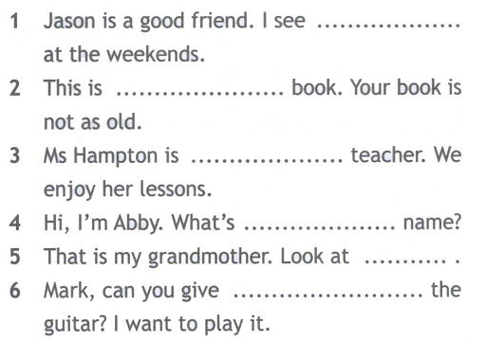

Slide 35
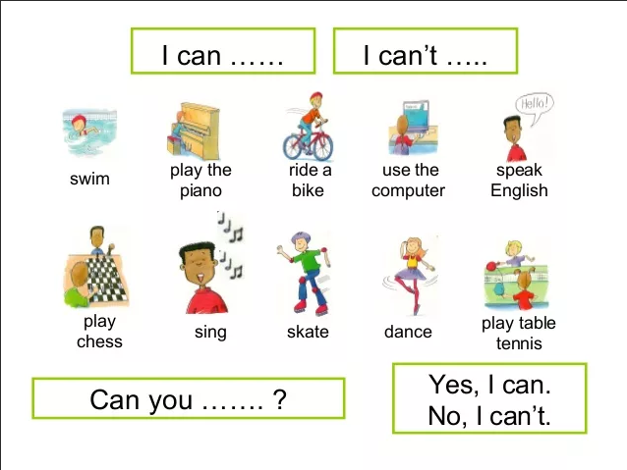

Slide 36
Materials
Glass
Stone
Marble
Brick
Wood

Slide 37
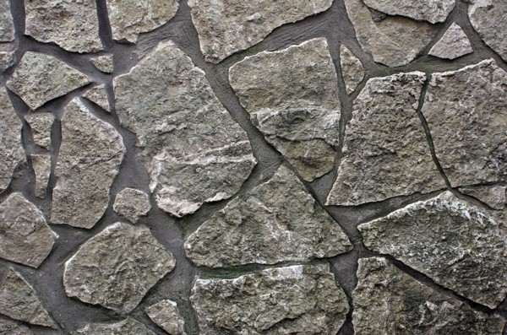
Stone

Slide 38
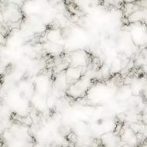
Marble

Slide 39
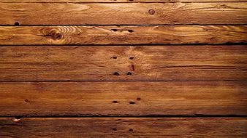
Wood

Slide 40
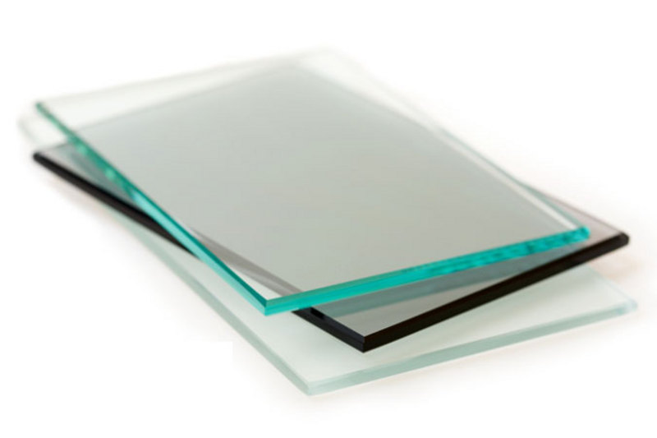
Glass

Slide 41
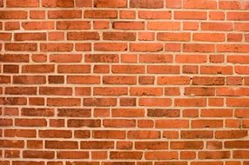
Brick

Slide 42
… is made of …
A house
A tower
A floor
A window
Furniture
A vase
A bridge

Slide 43
Shakira’s facts
Full name:
Is from:
Date of birth:
Family:
Hobbies:
She can:
Shakira Isabel Mebarak Ripoll
Barranquilla, Colombia, South
America
2nd February 1977
Four brothers and four sisters
Painting and listening to jazz
Speak five languages, dance and sing

Slide 44
Shakira’s full name is…….
She is from (place)…..
Her birthday is on (date)….
She has got…..
Her hobbies are…..
She can….

Slide 45
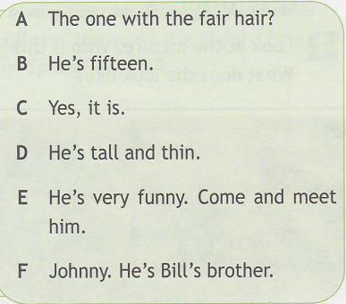

Slide 46
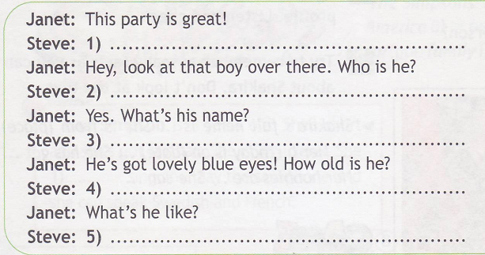





Slide 47
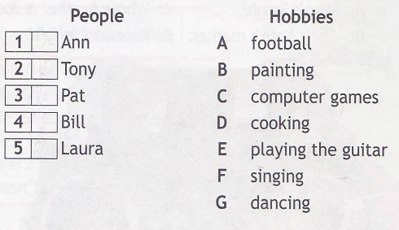
F
D
B
E
G

Slide 48
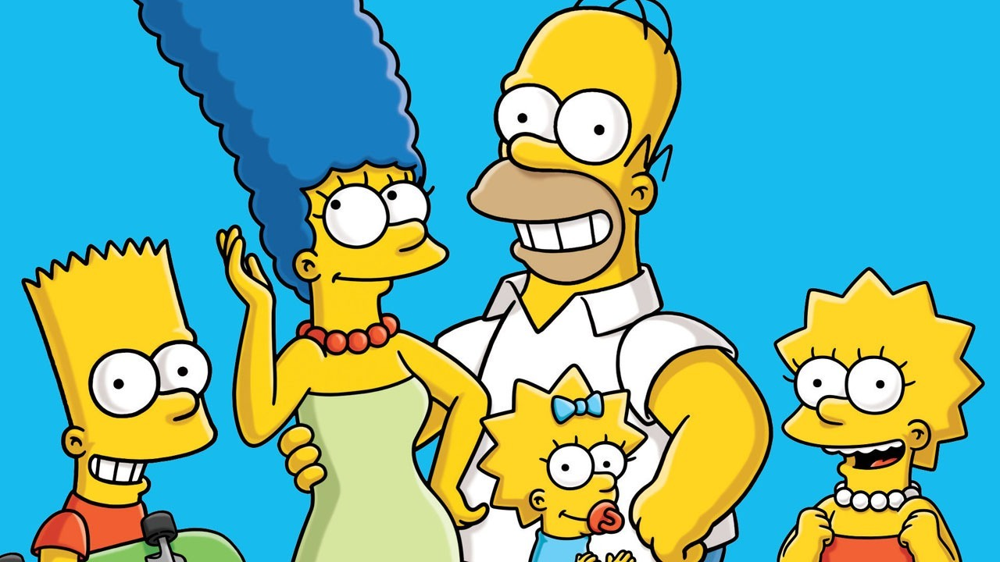
The Simpsons

Slide 49
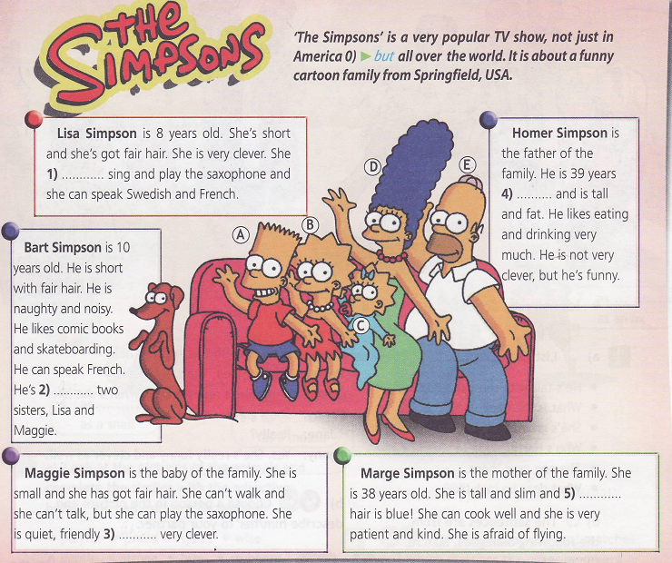
can
old
got
her
and

Slide 50
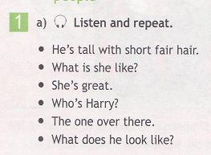

Slide 51
