Slide 1
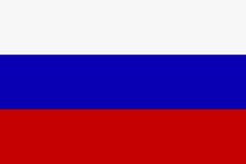
Guess the country according to the flag and make up sentences:
The Russian live in Russia and speak Russian

Slide 2
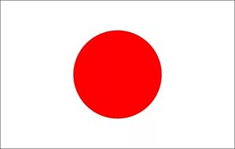
Japan, Japanese

Slide 3

The UK, British

Slide 4
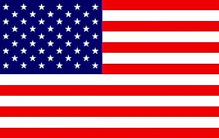
The USA, American

Slide 5
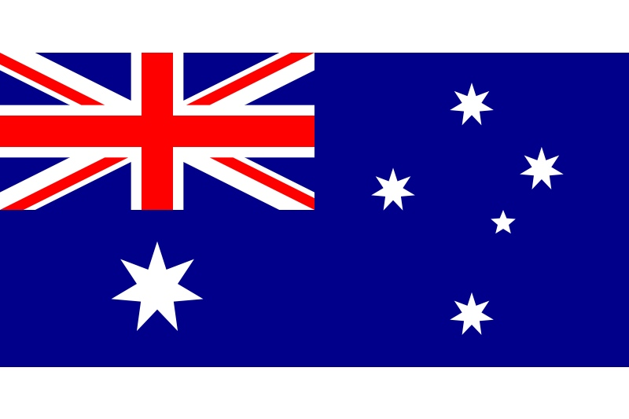
Australia, Australian

Slide 6
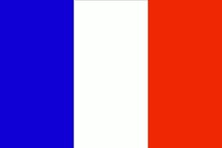
France, French

Slide 7
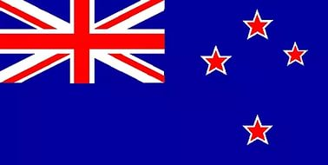
New Zealand, New Zealander

Slide 8
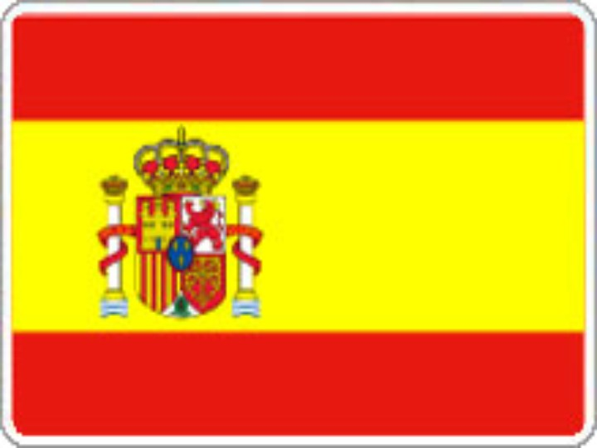
Spain, Spanish

Slide 9
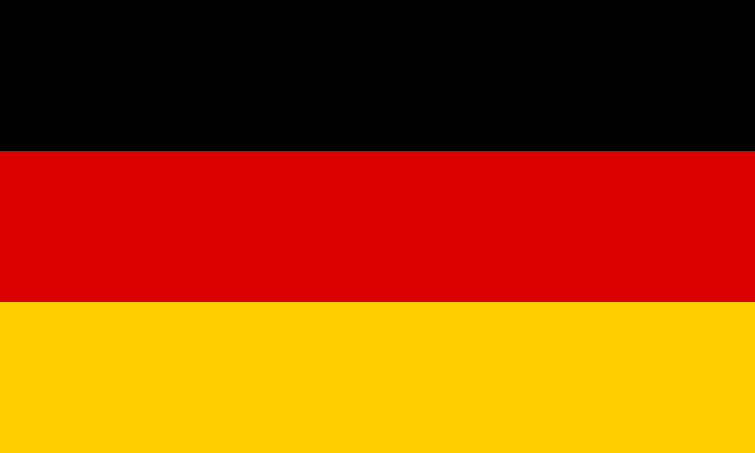
Germany, German

Slide 10

Finland, Finish

Slide 11
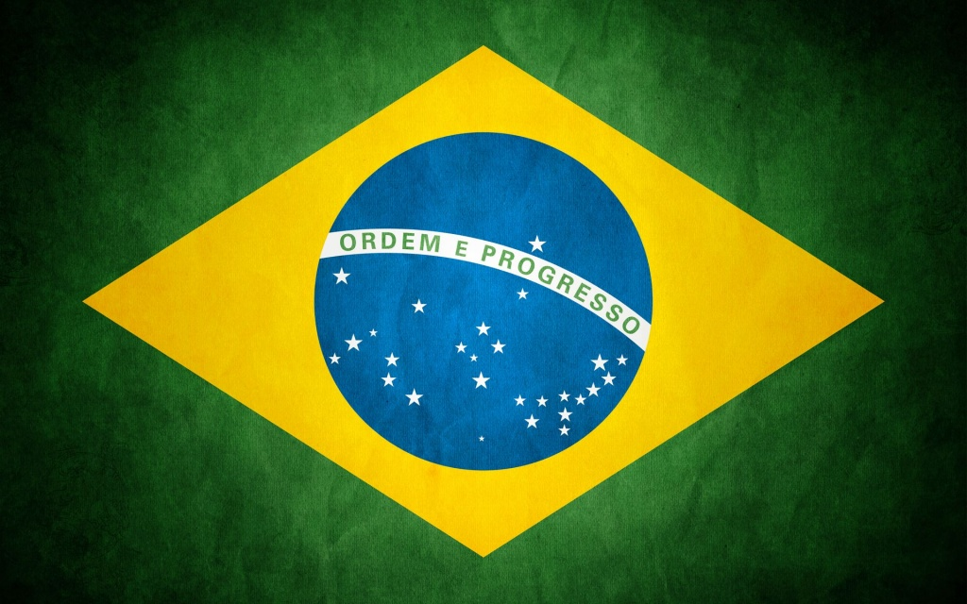
Brazil, Brazilian

Slide 12
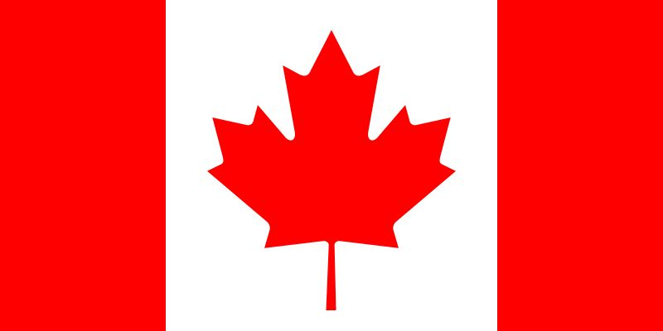
Canada, Canadian

Slide 13
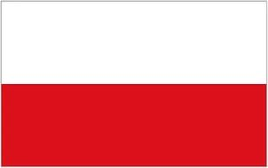
Poland, Polish

Slide 14

China, Chinese

Slide 15
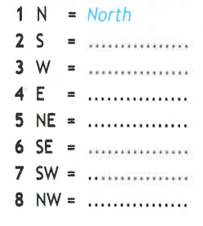

Slide 16
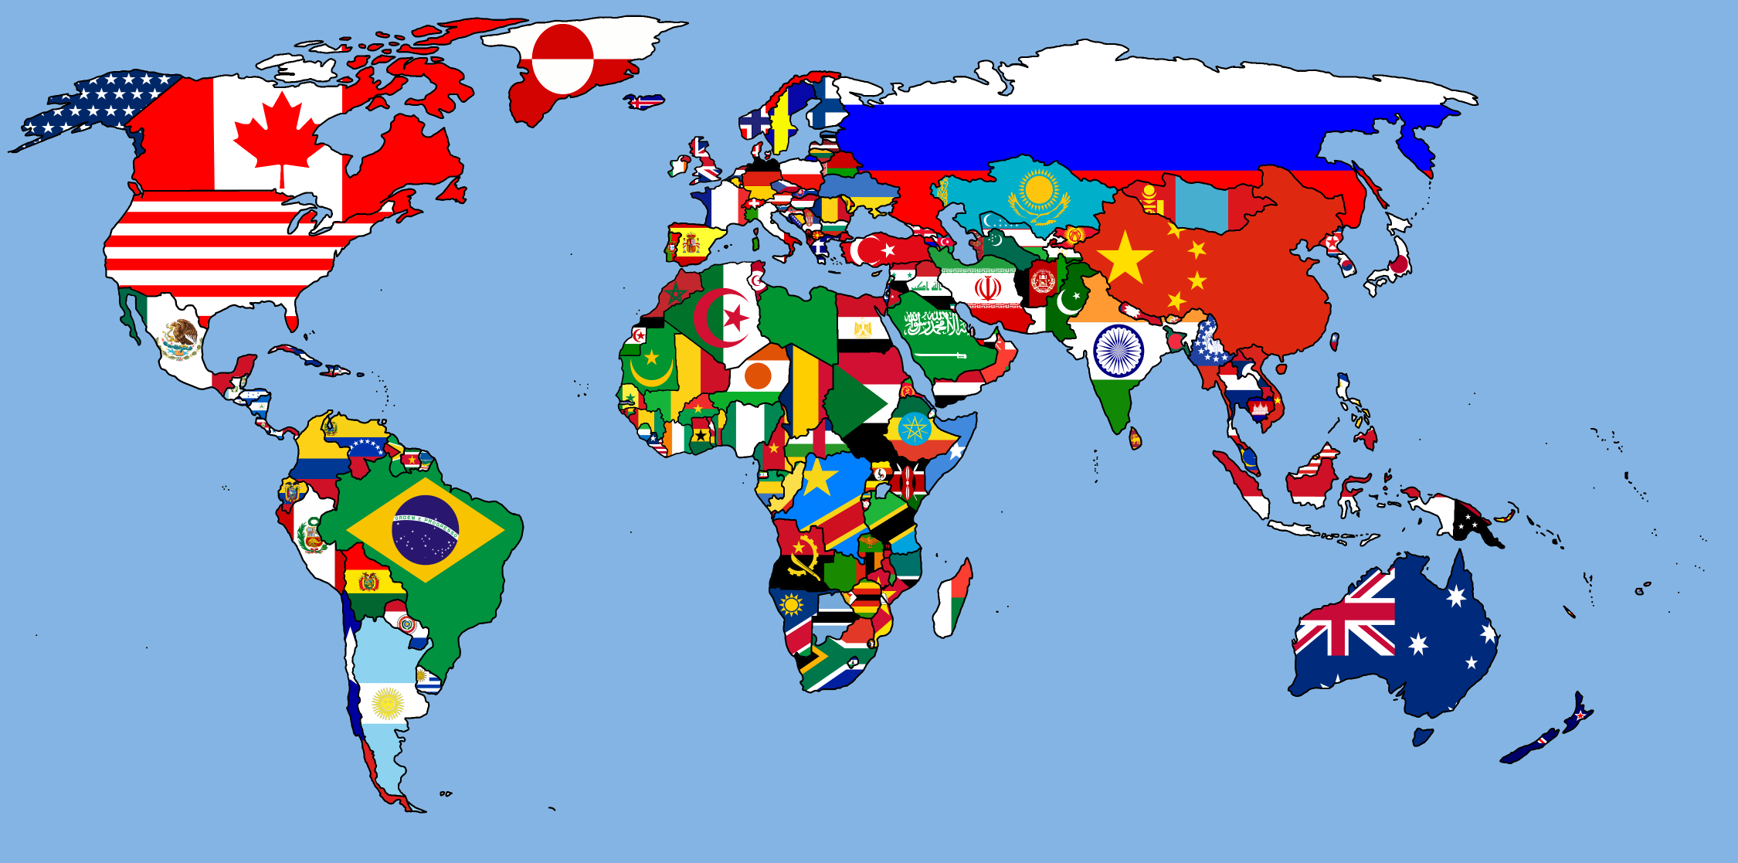
N
E
W
S

