Slide 1
What is the topic?
home
There is no place like …
… sweet …
East or West, … is best!
… is where the heart is.
home
home
home
home

Slide 2
The goals:
Describe where you live
Describe your flat / house
Furniture
Prepositions of place
British houses

Slide 3
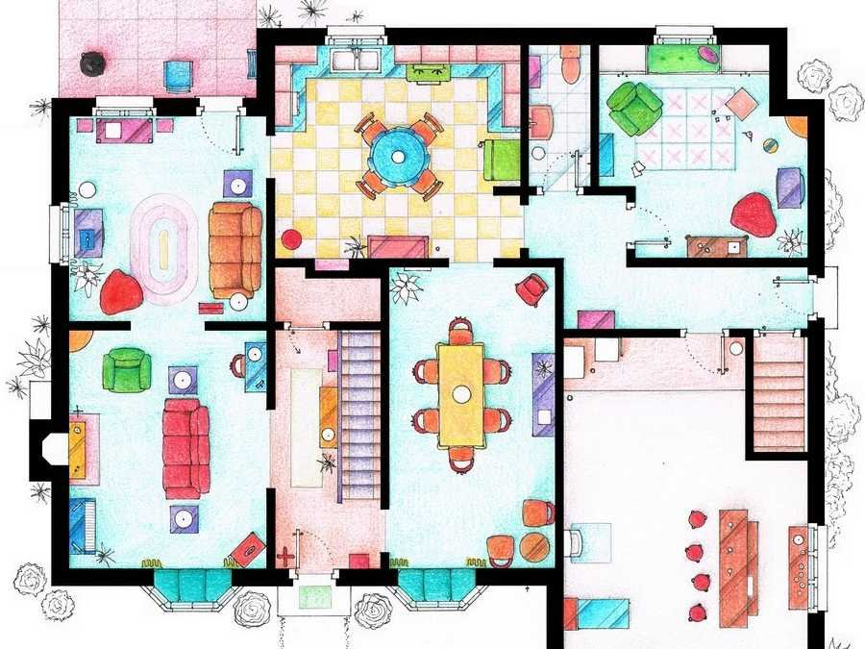

Slide 4
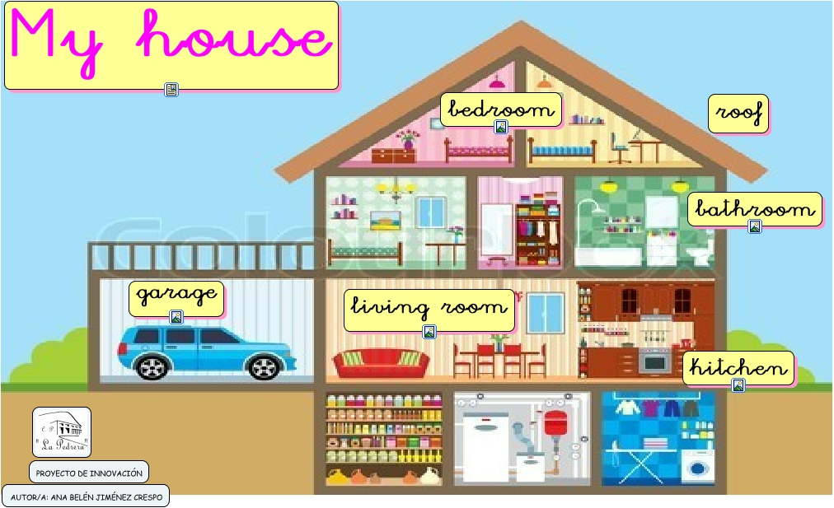
attic
laundry
pantry

Slide 5
My dream house
This is my dream house!
My dream house is…
It is …
It has got …
There is / are …
I wish I would live in my dream house some day.

Slide 6
Interesting building.
This is …
It is in … (what country?).
It’s made of …
It has got …
There is / are …
I’d like to visit it …
I visited it and I liked it very much.

Slide 7
Let’s correct the mistakes:
There is windows in the room.
There are windows in the room.
There is window in room.
There is a window in the room.
There are a door and 3 windows in the room.
There is a door and 3 windows in the room.
There is in room the windows.
There is a window in the room.
ЧТО?
ГДЕ?

Slide 8
Let’s correct the mistakes.
There is not window in the room.
There is no / not a window in the room.
There is a window in the room?
Is there a window in the room?
No, there is.
No there isn’t.

Slide 9
There is a table _________________ (в) the room.
There is a clock_________________ (над) the fireplace.
There is a picture________________ (на) the wall.
There is an armchair______________ (под) the shelf.
There is a table __________________ (между) the chair and the armchair.
There is a sofa __________________ (за) the armchair.
There is a lamp__________________ (рядом с) the piano.

Slide 10
in
There is a table _________________ (в середине) the room.
There is a clock_________________ (над) the fireplace.
There is a picture________________ (на) the wall.
There is an armchair______________ (под) the shelf.
There is a table __________________ (между) the chair and the armchair.
There is a sofa __________________ (за) the armchair.
There is a lamp__________________ (рядом с) the piano.
above
on
under
between
behind
next to

Slide 11
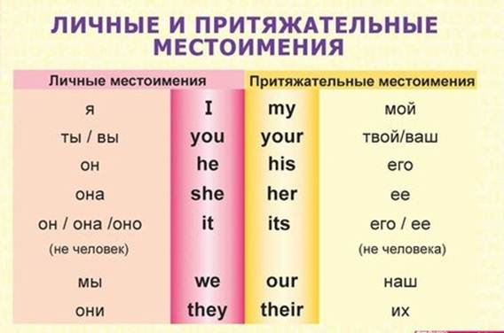

Slide 12
Hello! My/I name is Tim.
I/my am 10.
This is my/I sister. Her/she name is Liza.
He/his is my brother. His/he name is Nick.
I / my have got a pet. His/its name is Spot.
How old are you/your?
Where is she/they from?
What is your/you favourite subject?
Where are you/she from?

Slide 13
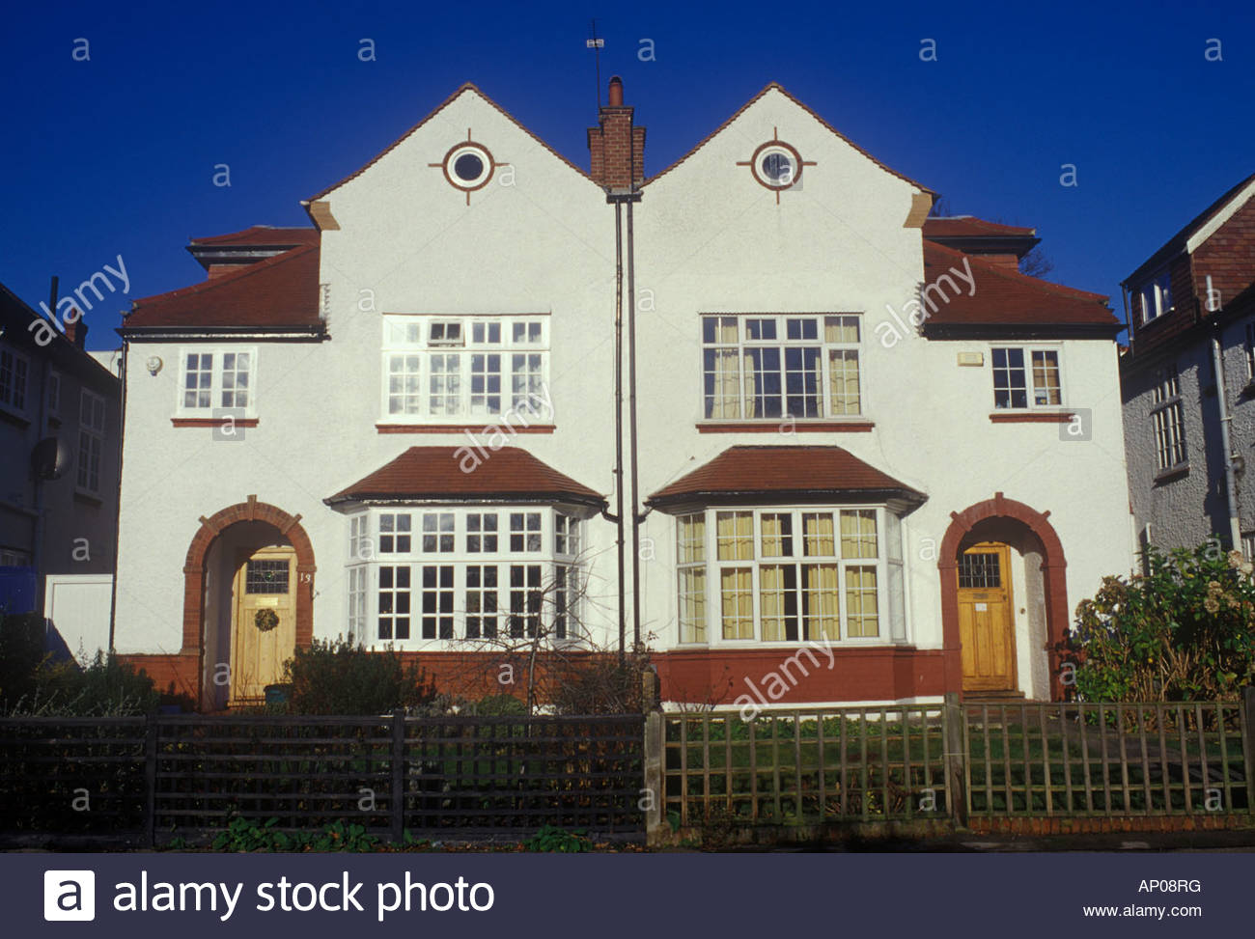
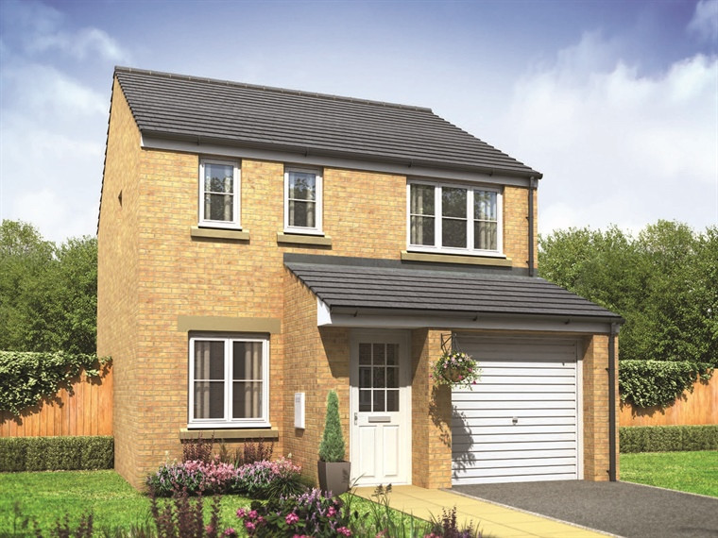
A semi-detached house
A detached house

Slide 14
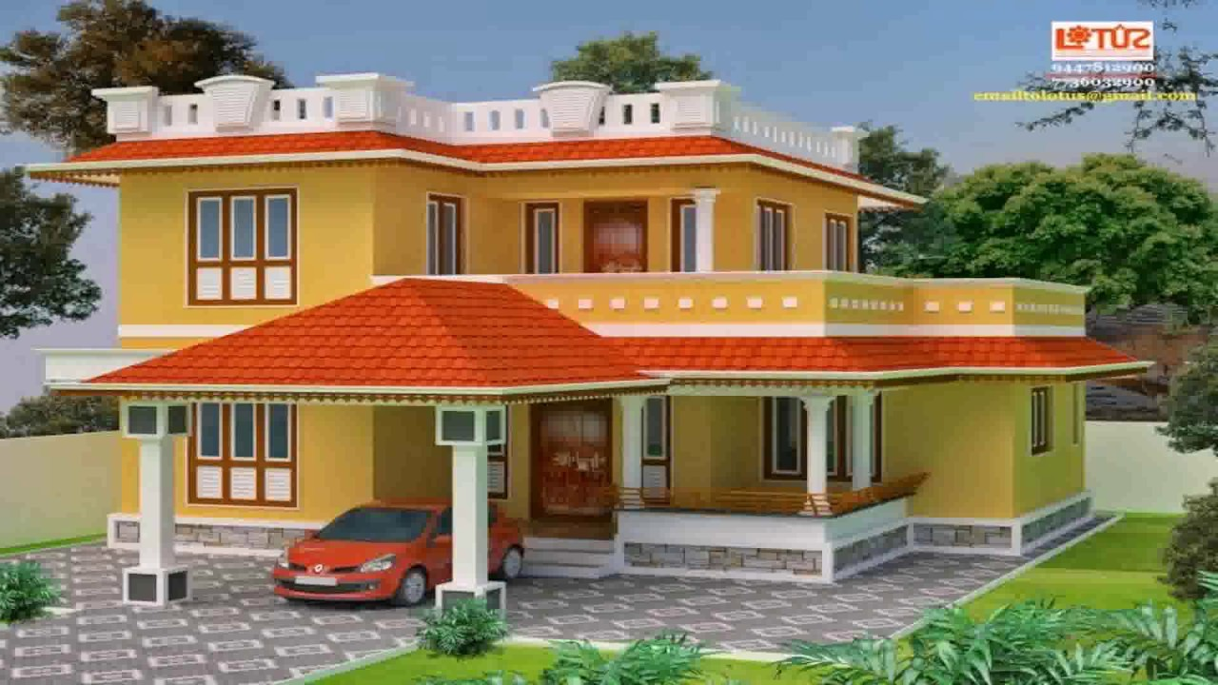
1. upstairs. 2. downstairs.
1.
2.

Slide 15
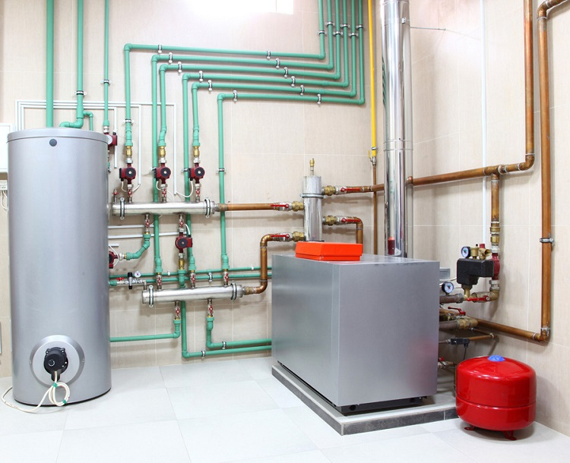
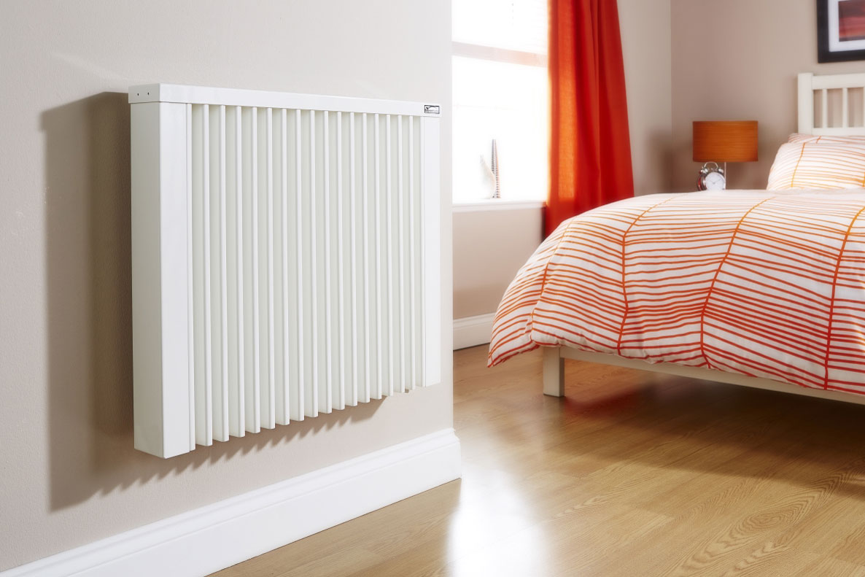
Central heating

Slide 16
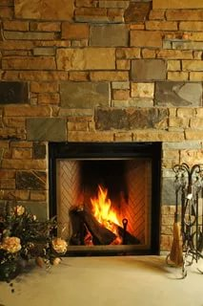
A fireplace

Slide 17
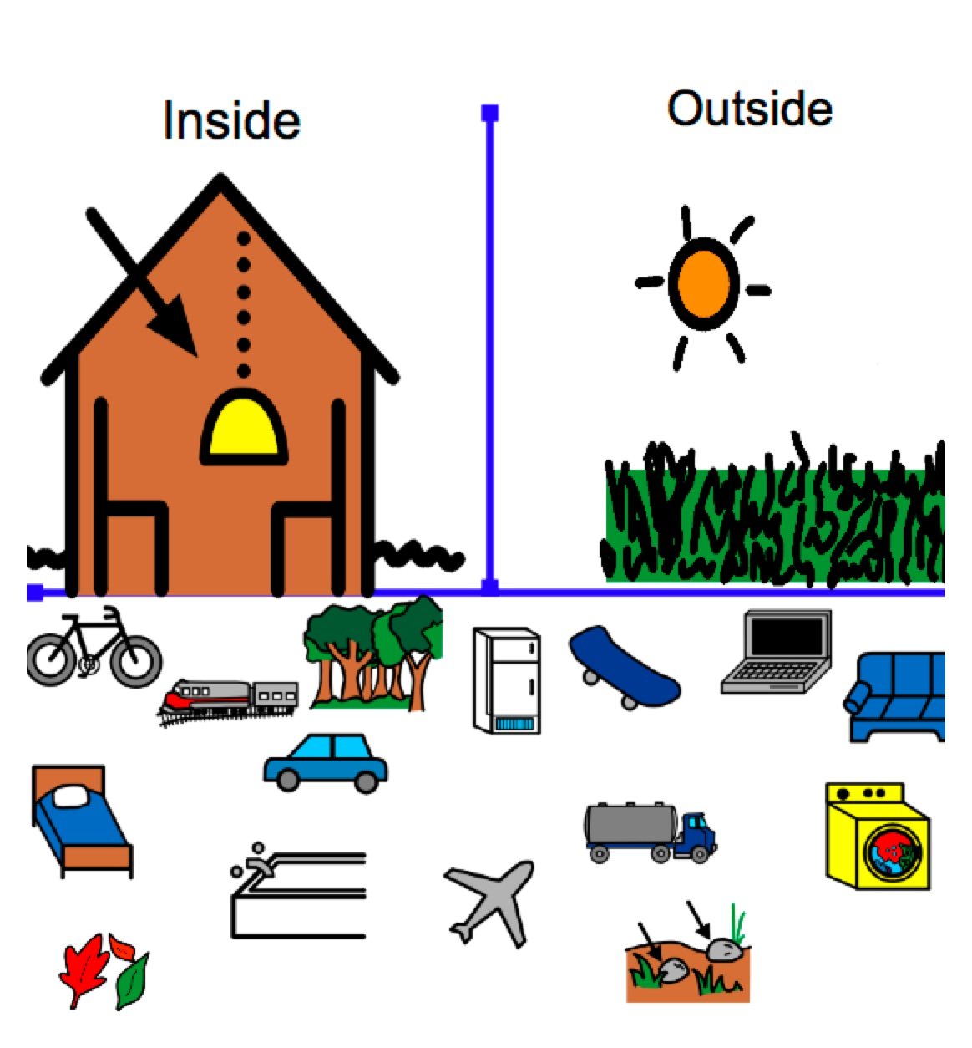
внутри?
снаружи?

Slide 18
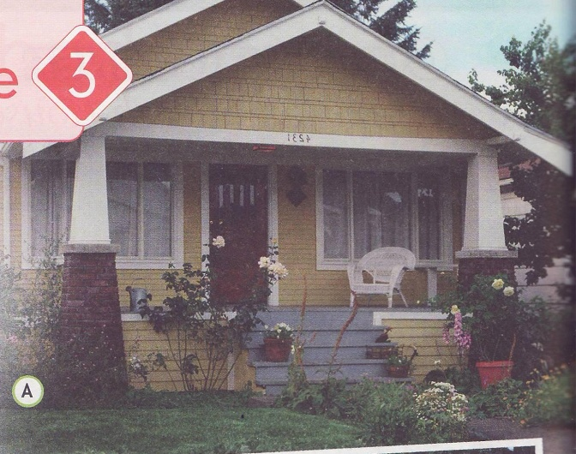
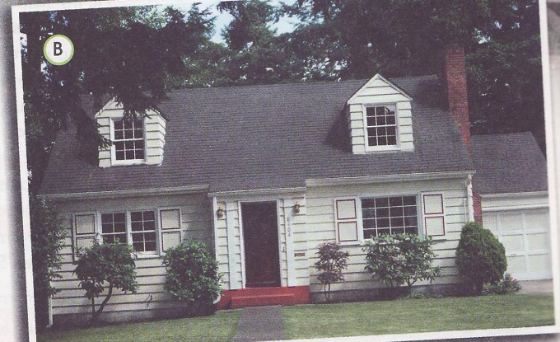

Slide 19
Ask these questions to your partner:
Where do you live?
What floor do you live on?
How many rooms are there in your flat?
What is your favourite room?
What is there?
Why do you like it?

Slide 20
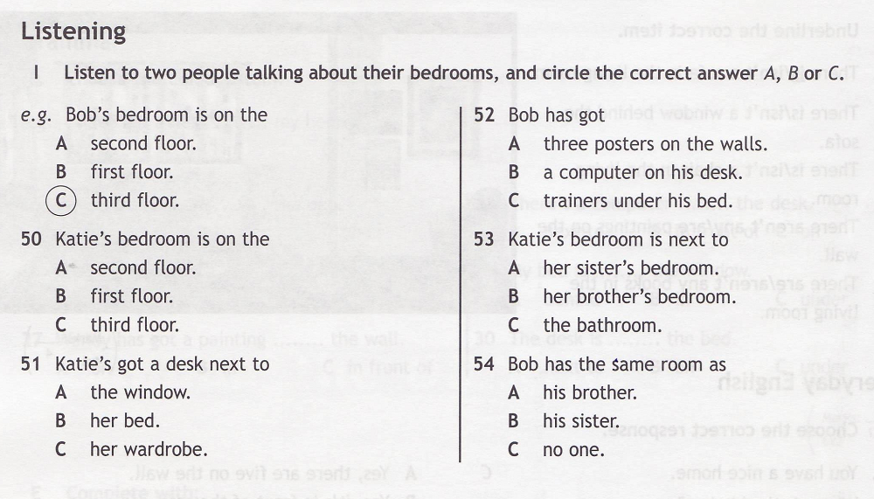

Slide 21


The, father, path, thunder, thirtieth, those, that, bath, maths, this, there, think

Slide 22
The, father, path, thunder, thirtieth, those, that, bath, maths, this, there, think
The | Path
Father | Thunder
Those | Thirtieth
That | Bath
This | Maths
There | Think

Slide 23
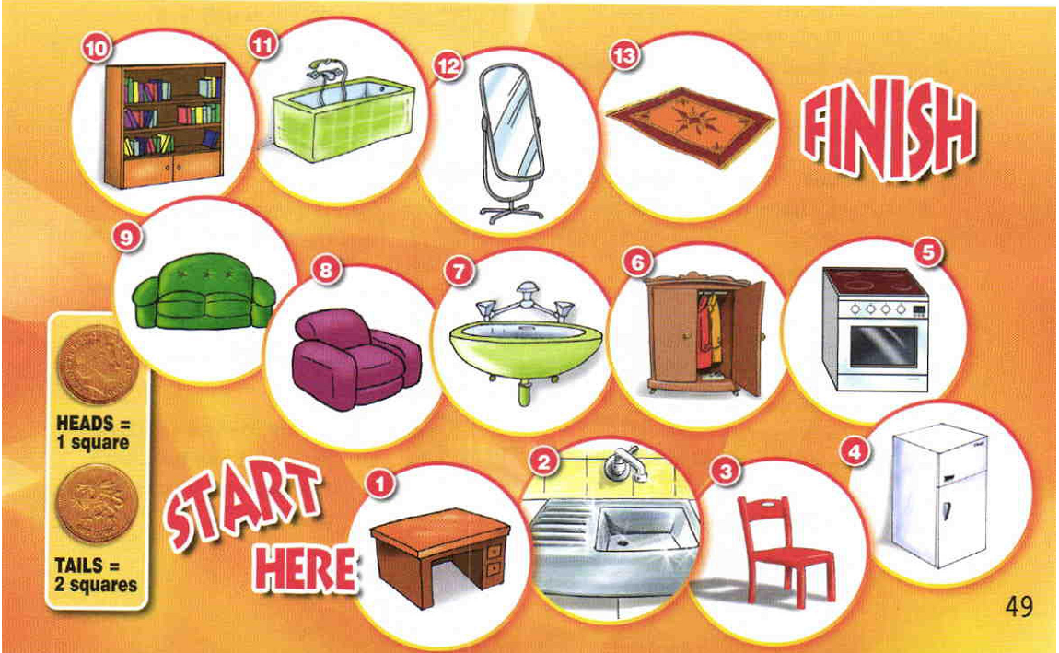

Slide 24
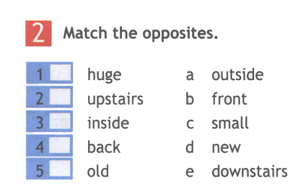

Slide 25
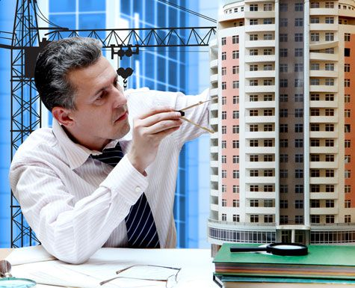
An architect

Slide 26
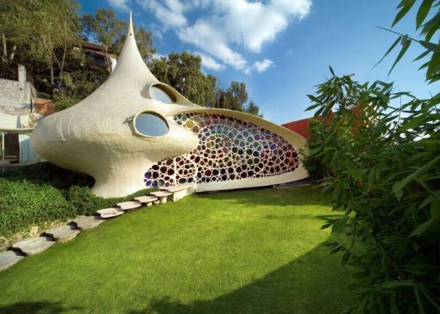
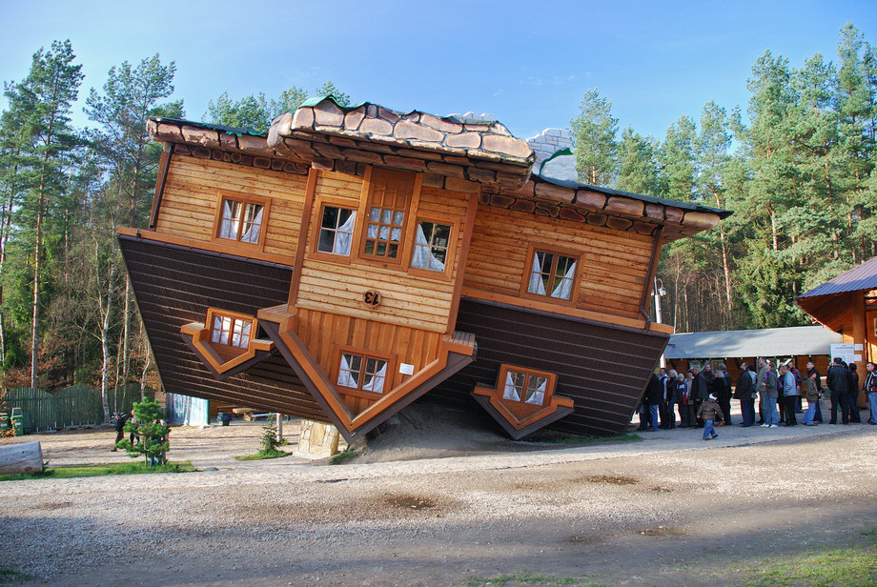
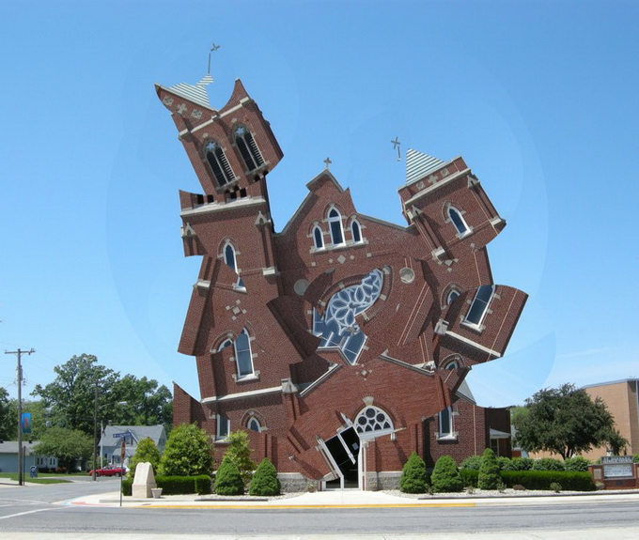
An unusual house

Slide 27
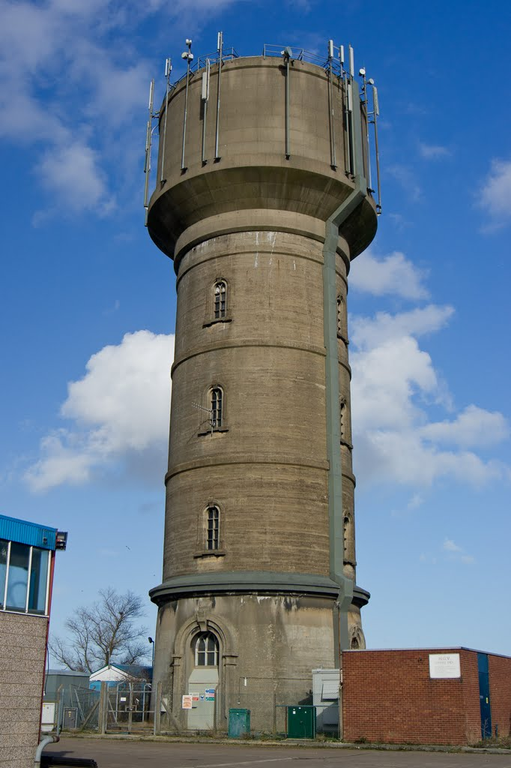
A water tower

Slide 28
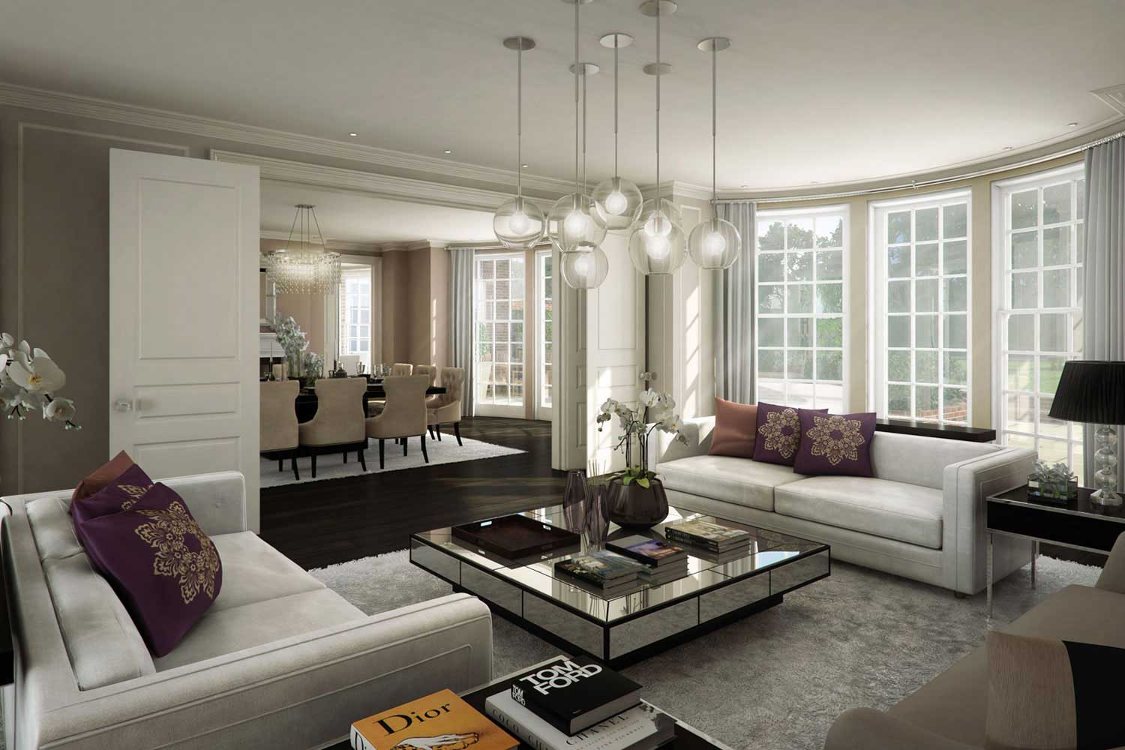
A reception room

Slide 29

Steps

Slide 30
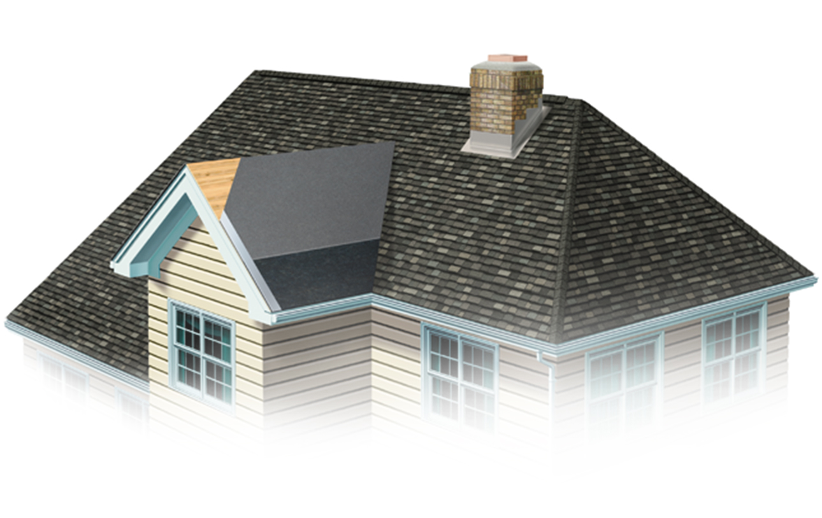
A roof

Slide 31

Keep fit

Slide 32


Slide 33
What do these mean?
The Mediterranean sea
Huge
Dot

Slide 34
five
floors, bathrooms
15
garden
pedro

Slide 35


